Slide 1
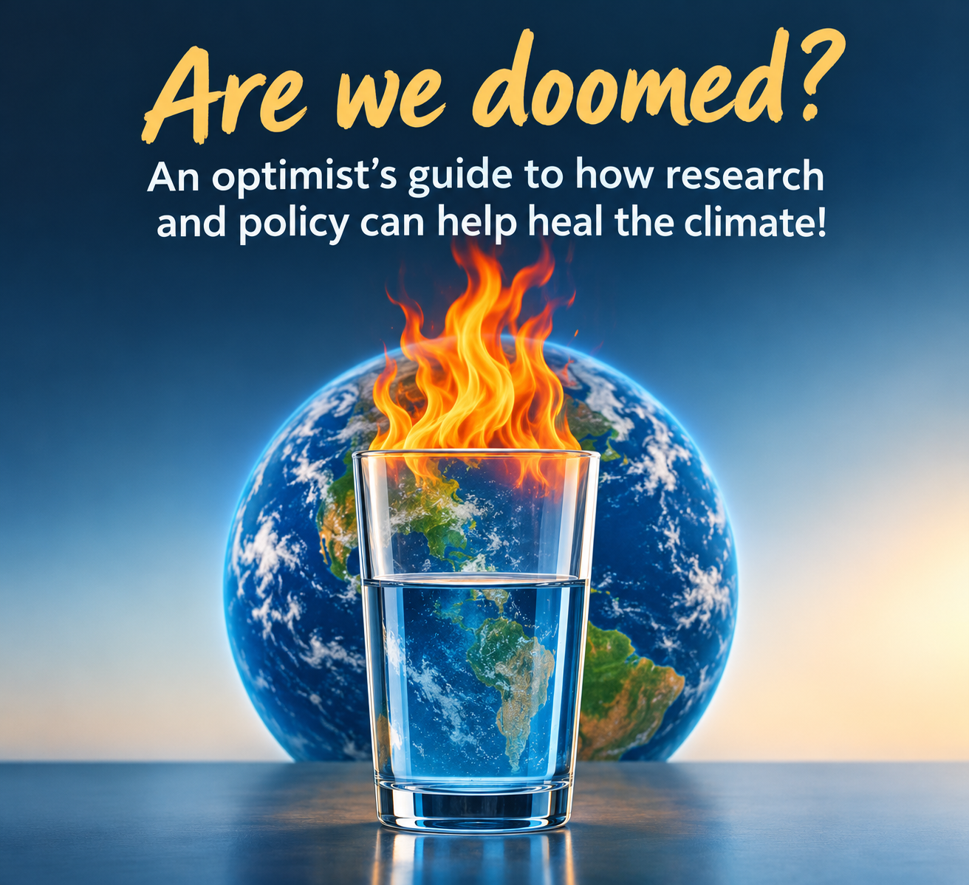
Ankur Desai
Dept of Atmospheric &
Oceanic Sciences
University of Wisconsin-Madison
Cottage Grove Library
19 October 2025

Slide 2
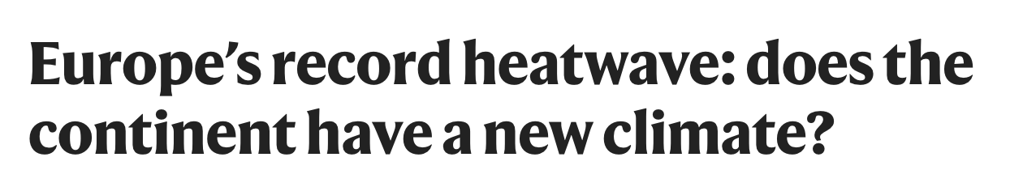
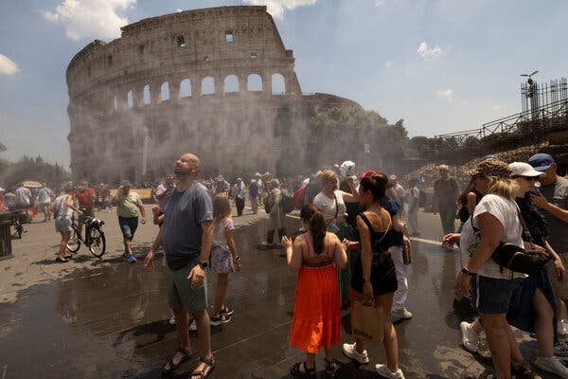
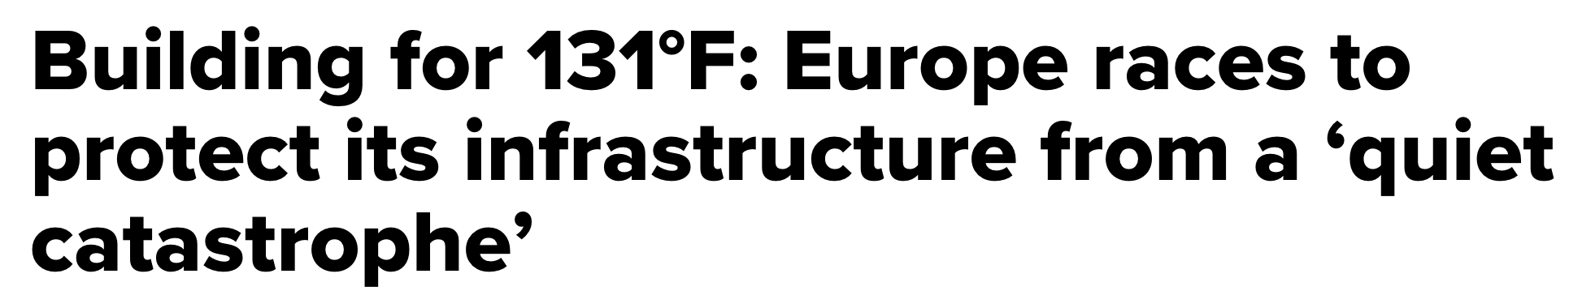
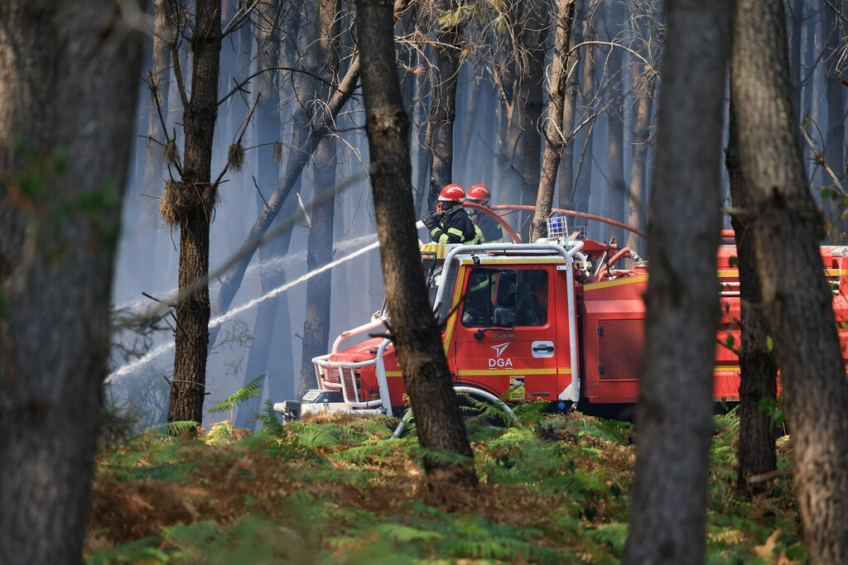
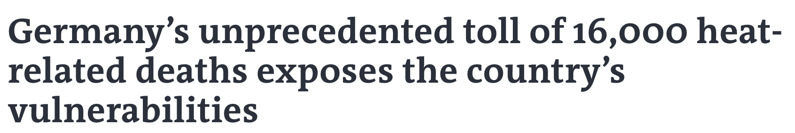
Animation: NASA, Photos/News: NYTimes, LaMonde, InsideClimateNews

Slide 3
You might wonder…
Did a warming climate make this event more likely?
Could we improve warnings about this in advance?
Can we decrease the harm from events like this and help communities be safer?
YES!

Slide 4
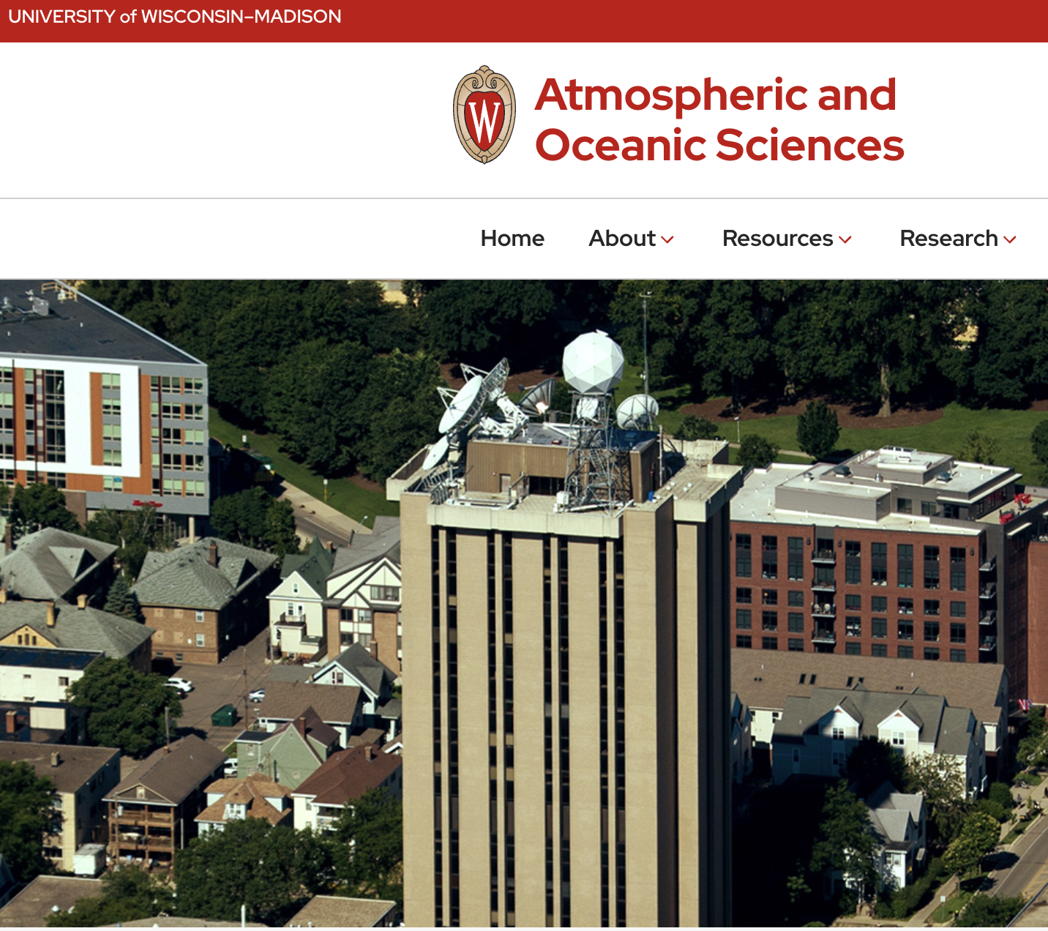



Slide 5
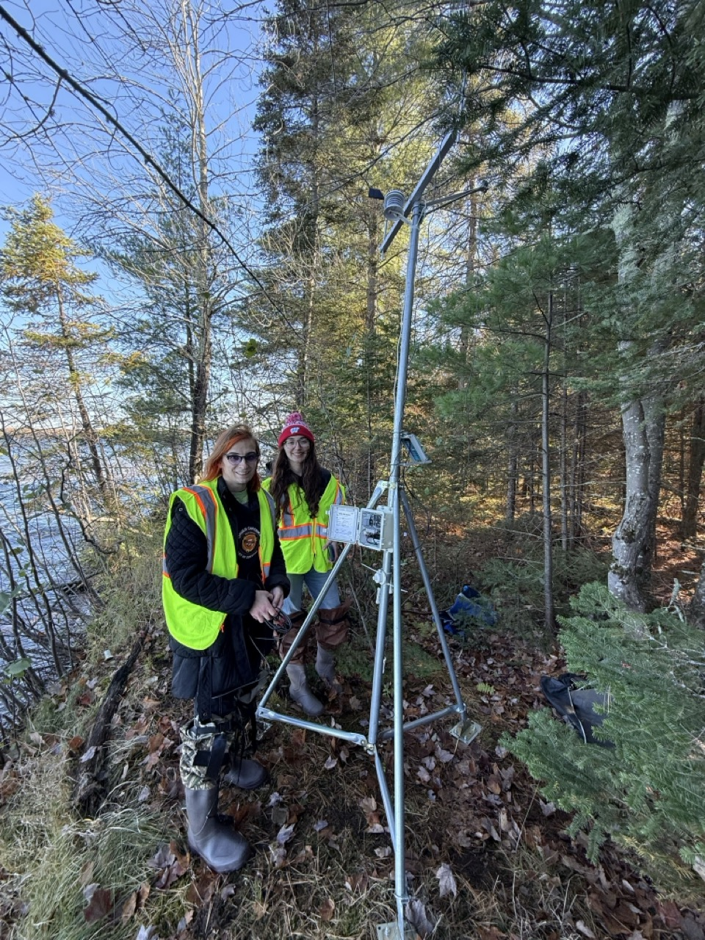
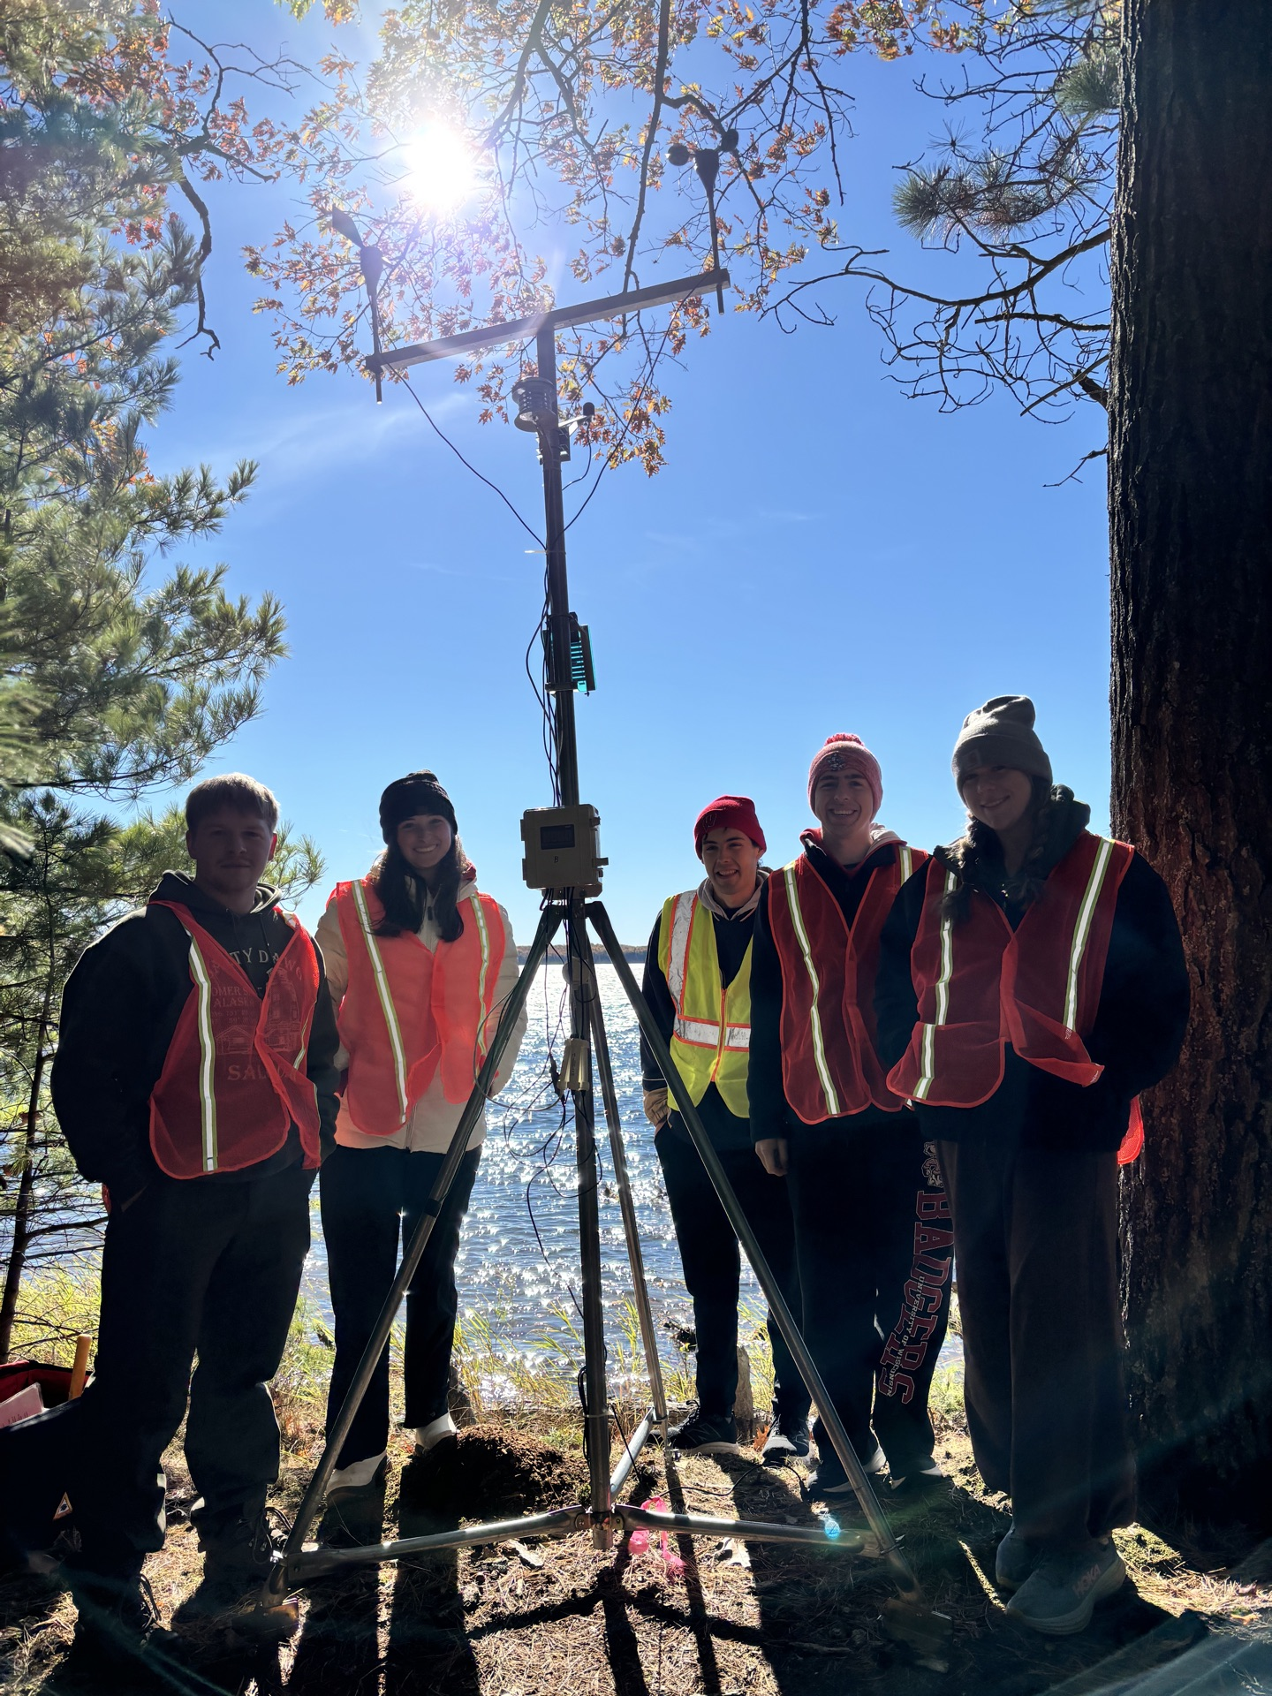
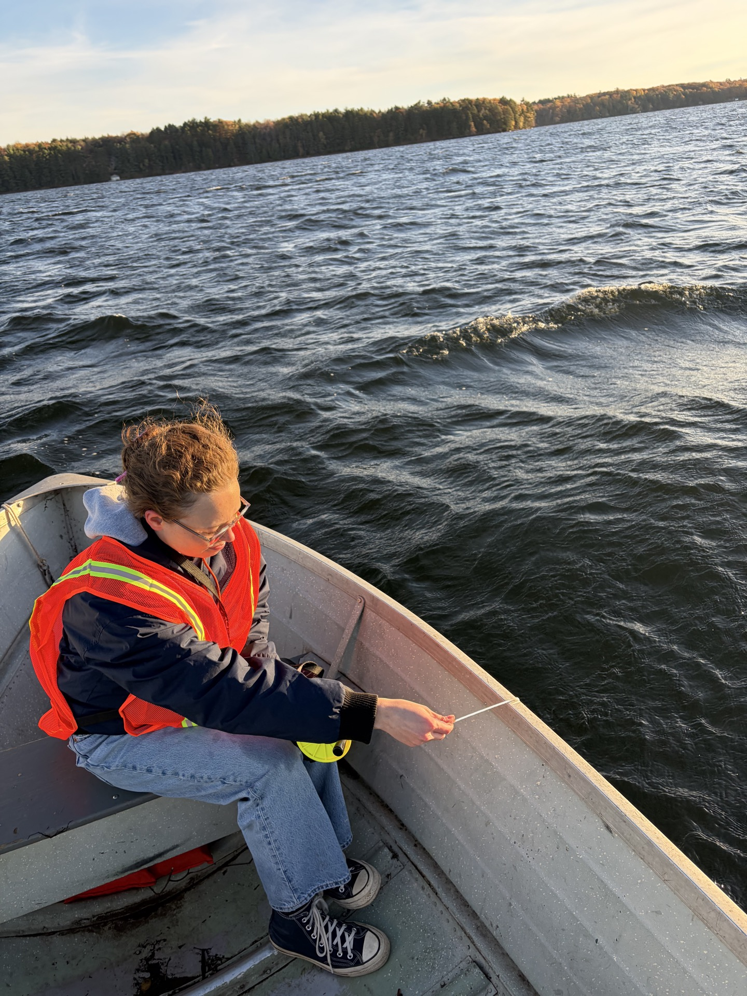
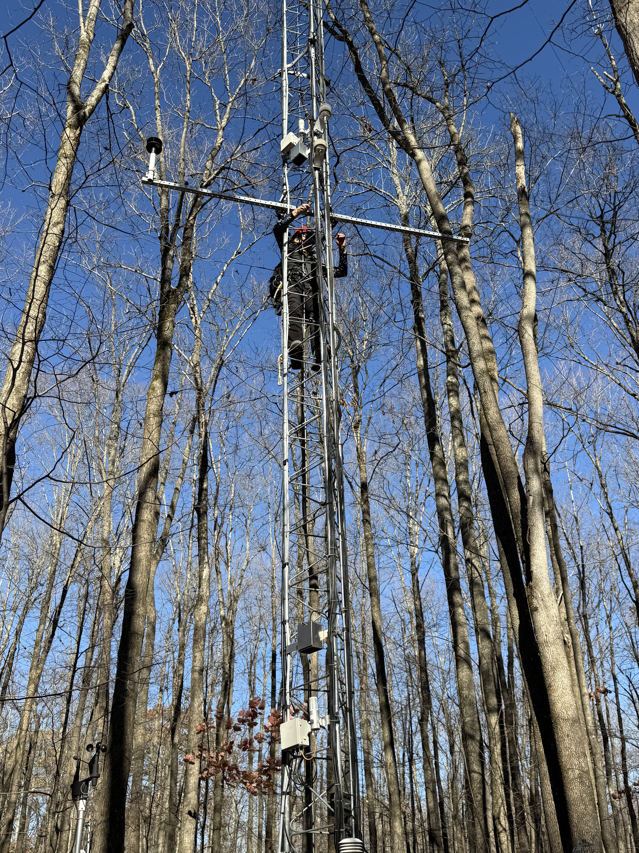
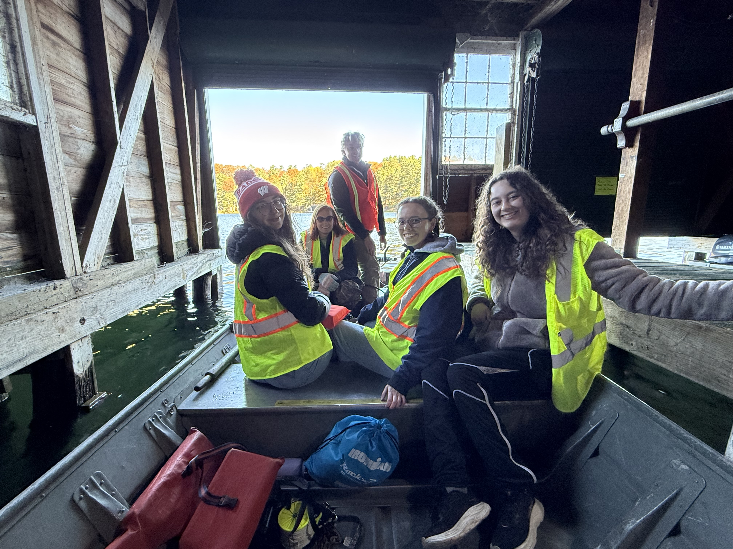
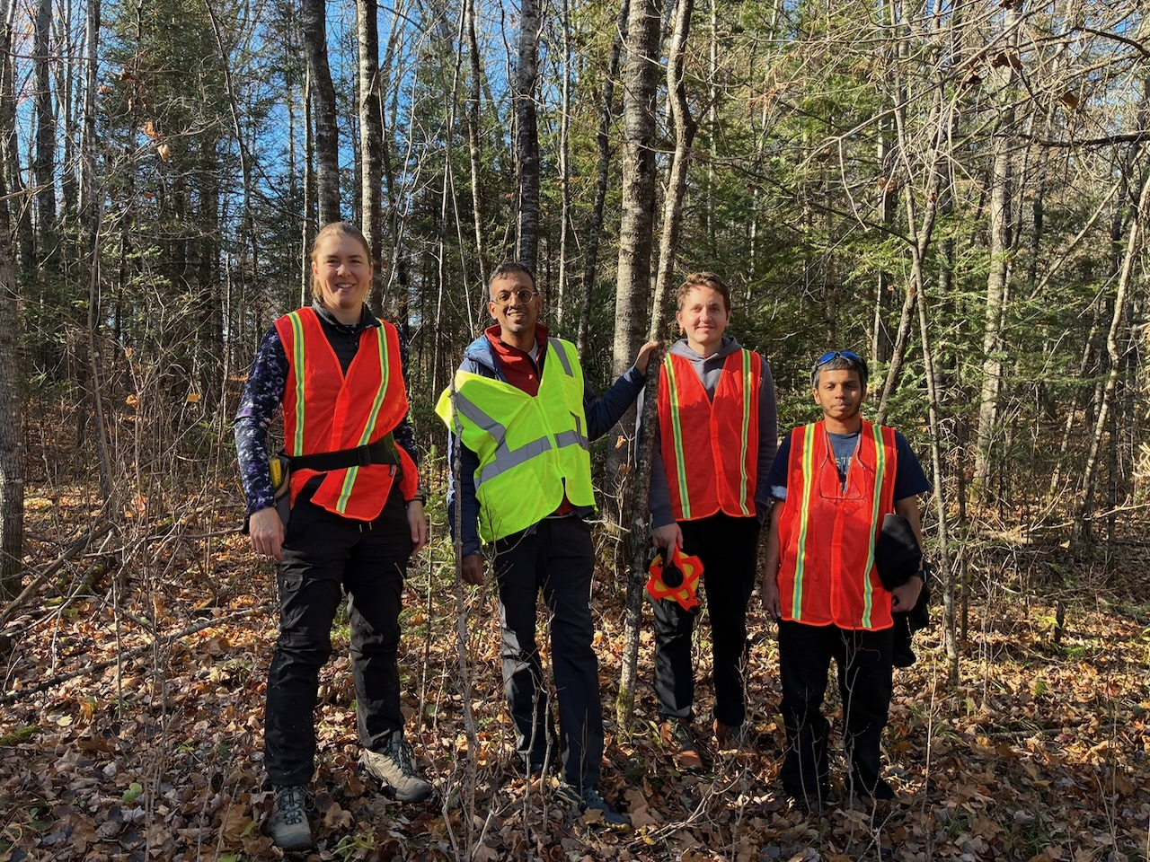

Slide 6
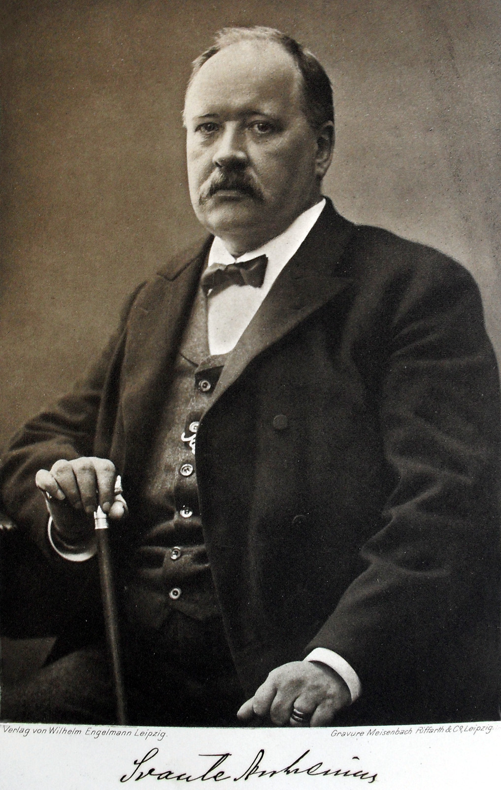
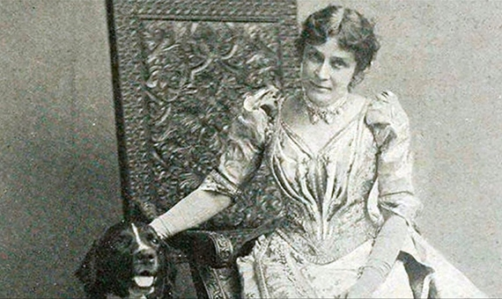
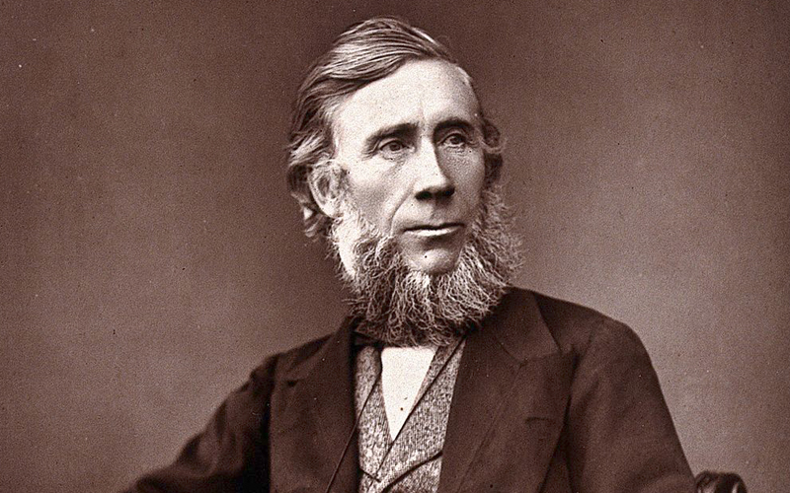
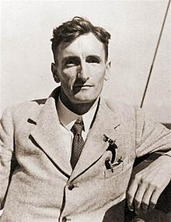
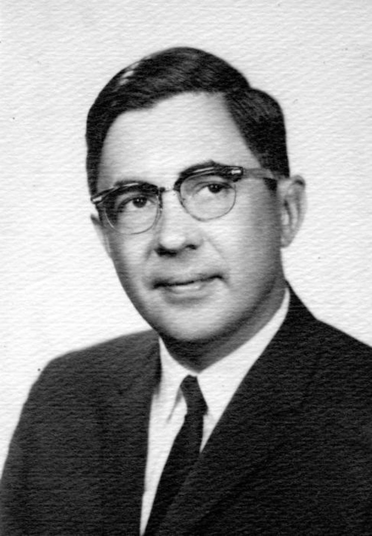
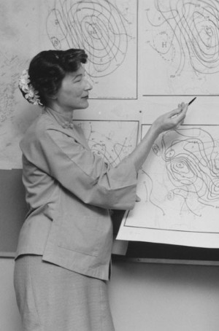
They stand on a long legacy
Tyndall 1859
Eunice Foote 1856
Arrehenius 1896
Callendar 1938
Plass 1953
Simpson 1958

Slide 7
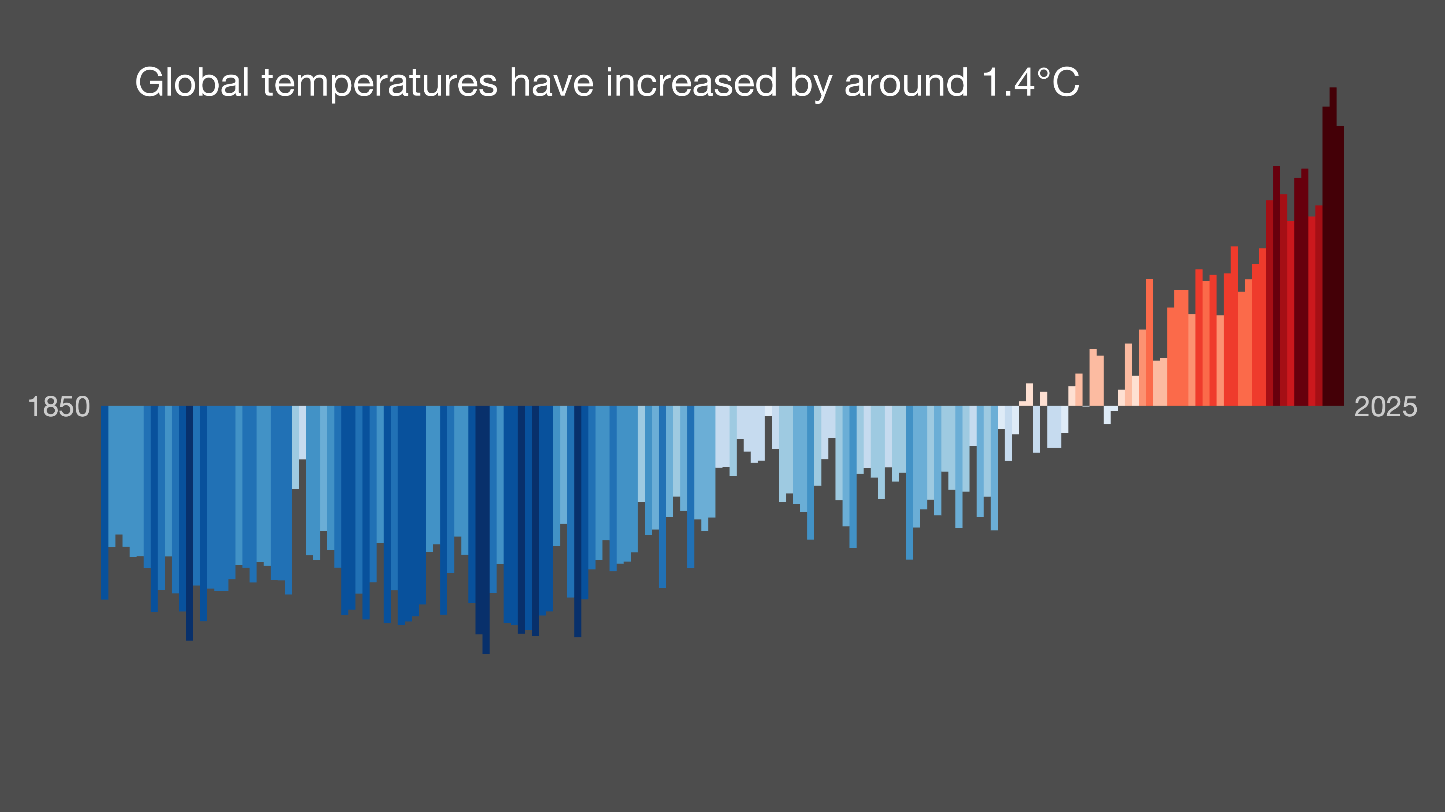
What can YOU do about climate change?
A little
showyourstripes.info

Slide 8
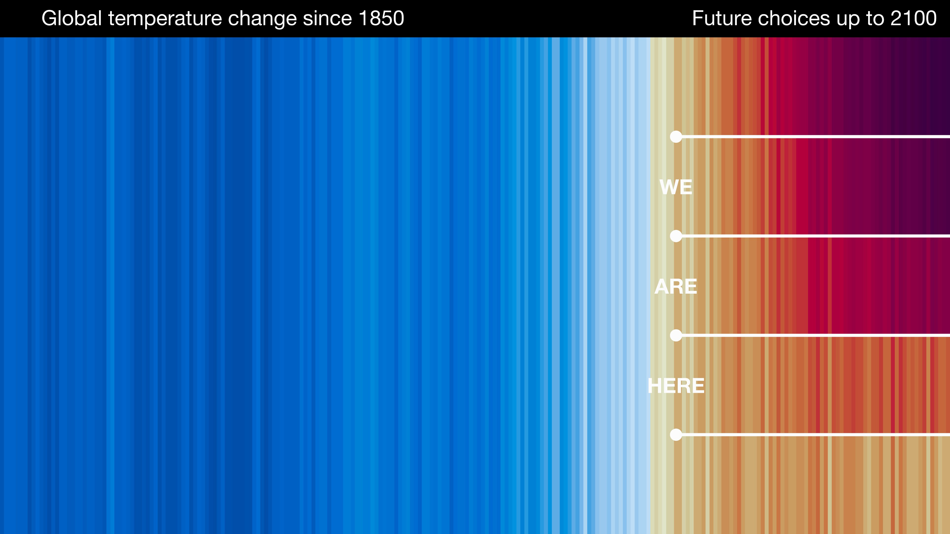
What can WE do about climate change?
A lot!
Ed Hawkins

Slide 9
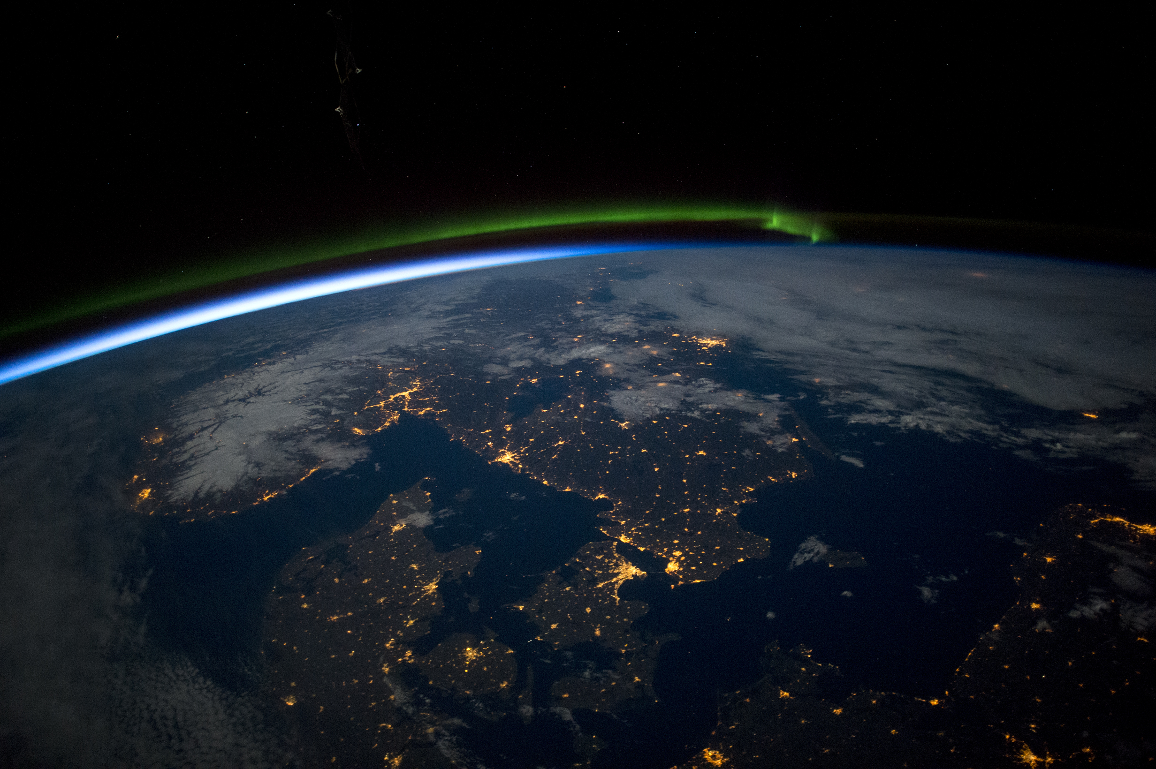
NASA ISS

Slide 10
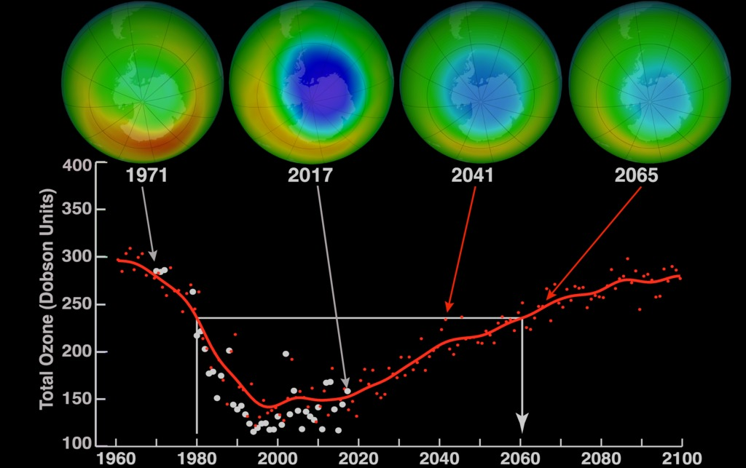
Credits: NASA

Slide 11
What do we know
It’s happening
It’s us
It’s harmful
We are learning more every day on how to reduce that harm through science, technology, policy, and common purpose

Slide 12
Climate = Average of Weather over space and time, typically regions and decades
Climate is what you expect
  Weather is what you get
Climate is your personality
  Weather is your mood

Slide 13
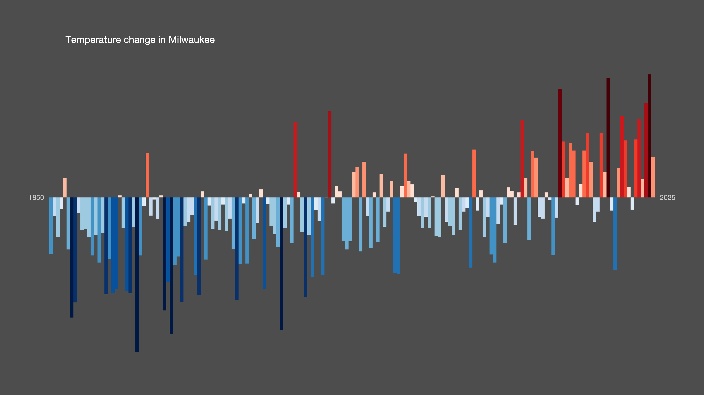
Show Your Stripes, Ed Hawkins

Slide 14
Show Your Stripes, Ed Hawkins

Slide 15
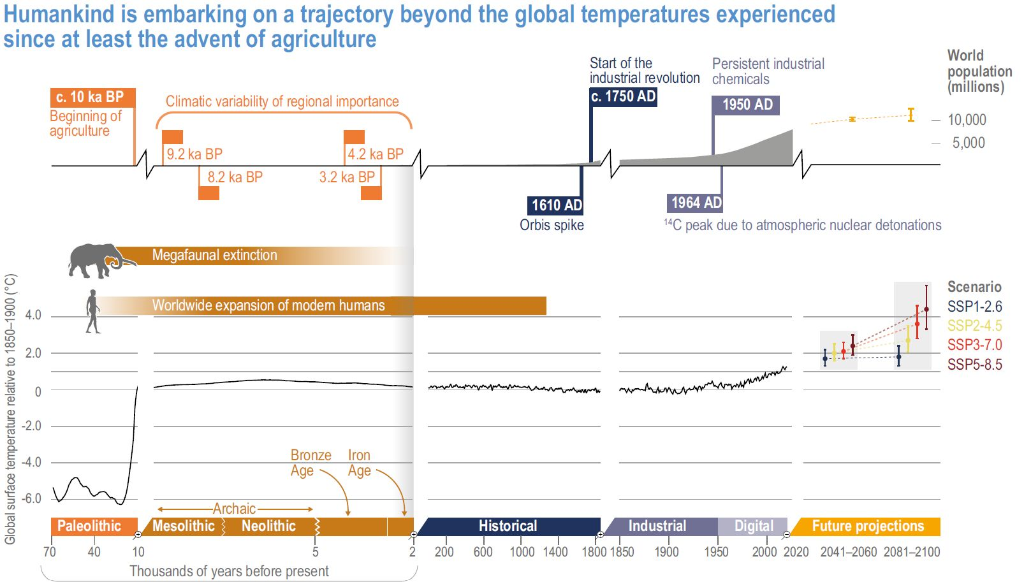

Slide 16
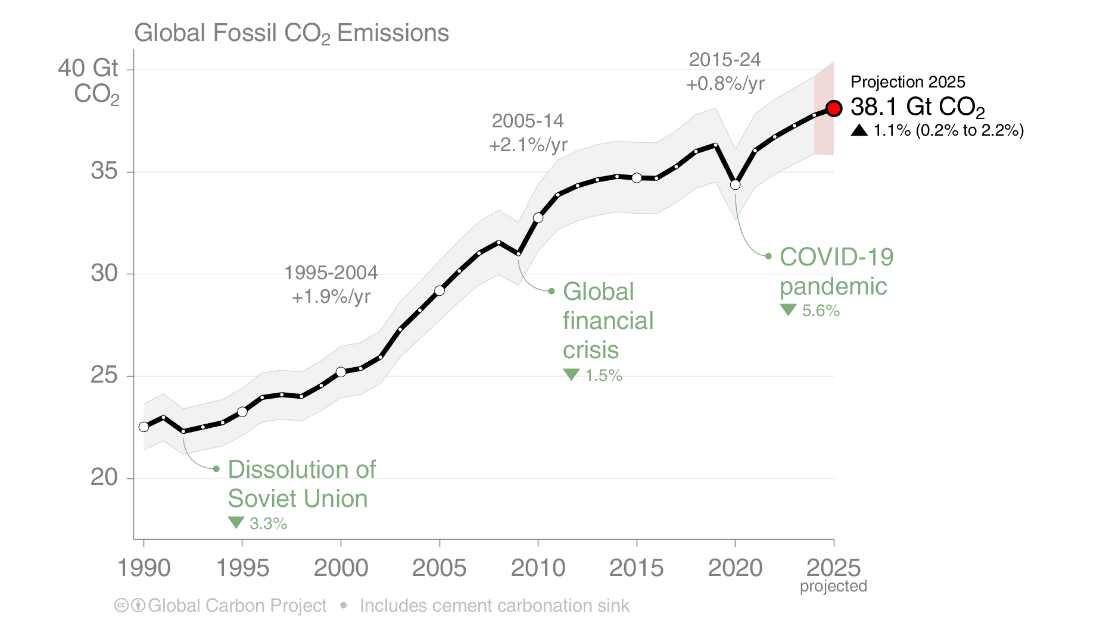
Global Fossil CO₂ Emissions
Global fossil CO₂ emissions: 37.8 ± 2 GtCO₂ in 2024, 69% over 1990
Projection for 2025: 38.1 ± 2 GtCO₂, 1.1% [0.2% to +2.2%] higher than 2024
The 2025 projection is based on preliminary data and modelling. The global total includes a cement carbonation sink of 0.8 GtCO₂.
Source: Friedlingstein et al 2025; Global Carbon Project 2025

Slide 17
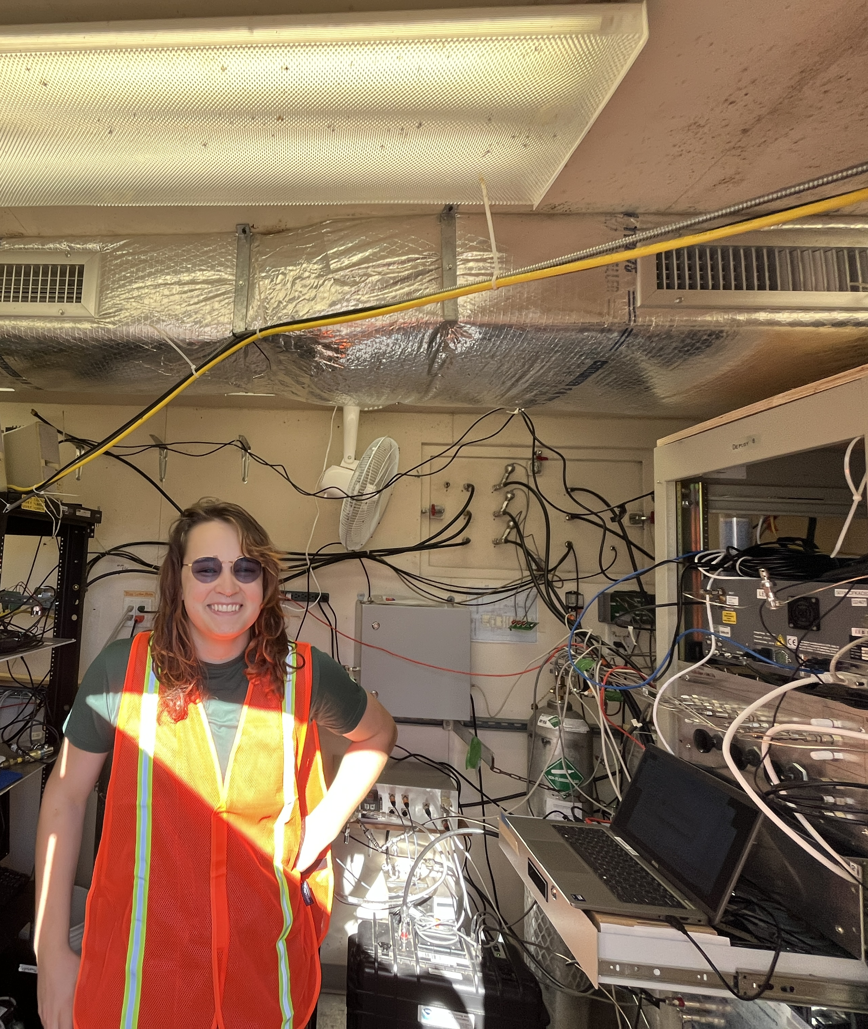
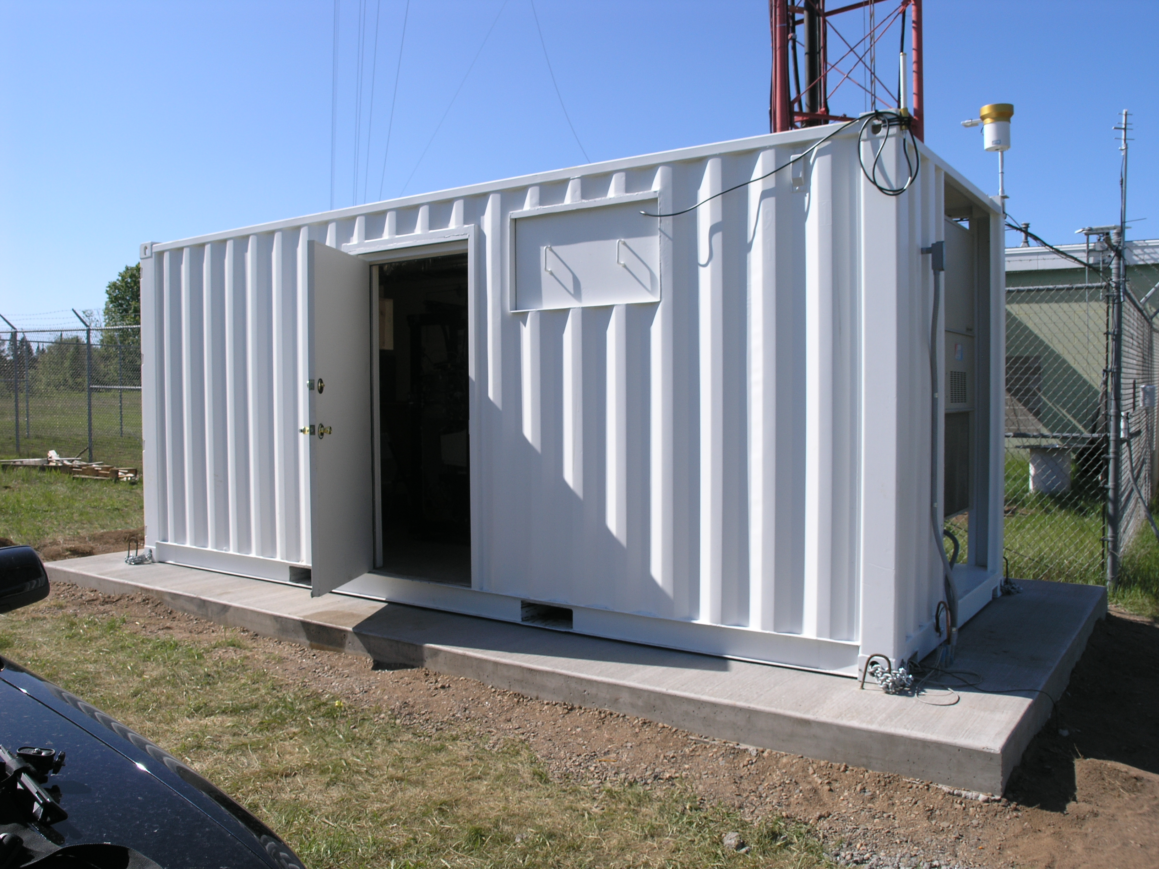
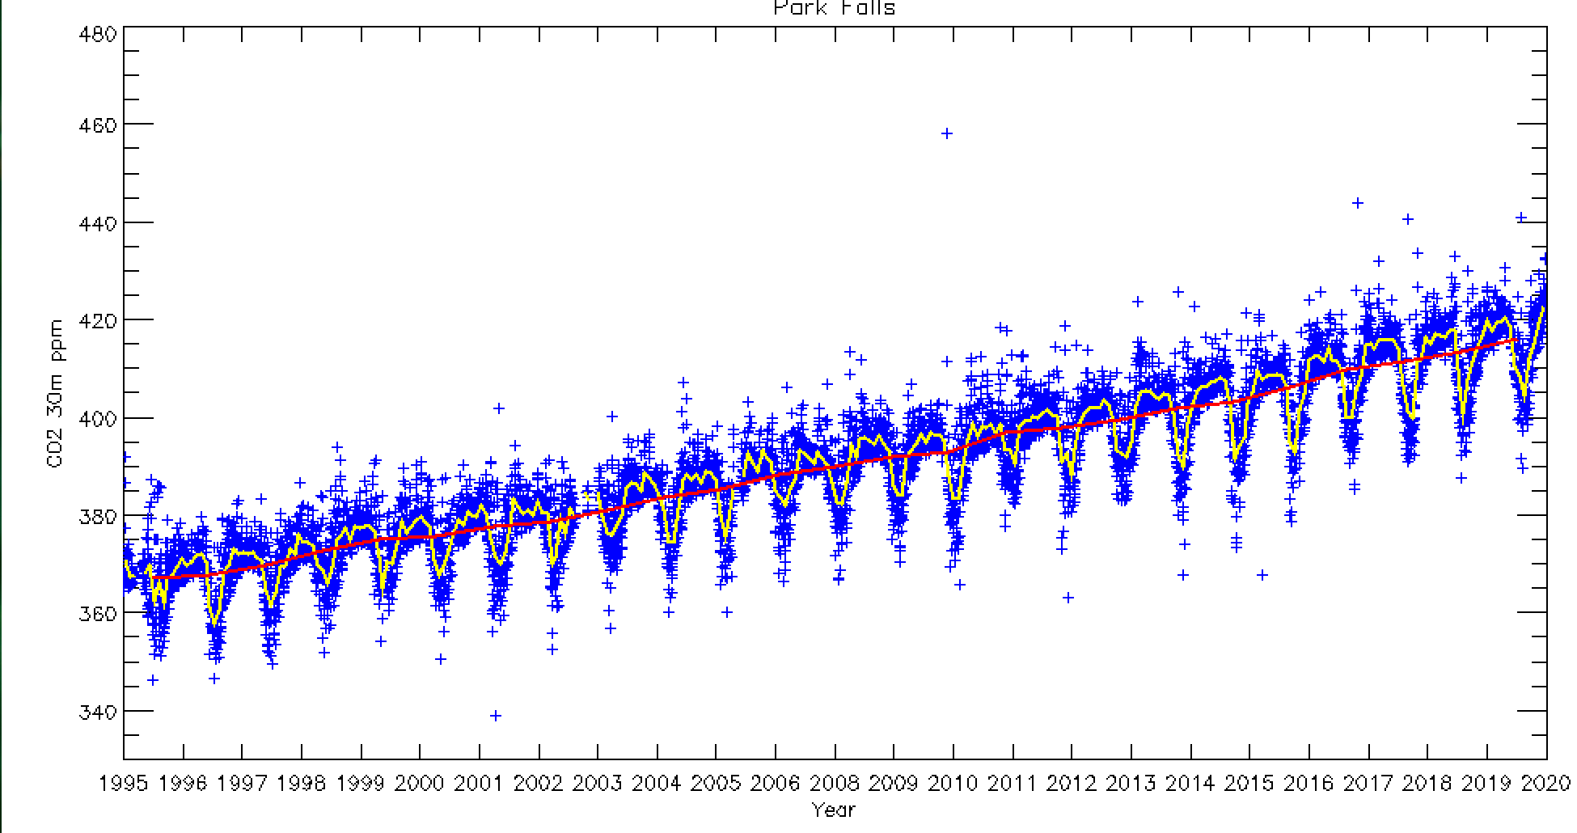

Slide 18
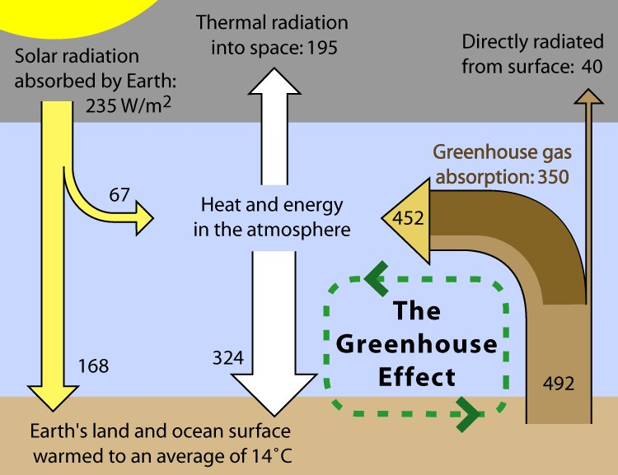

Slide 19
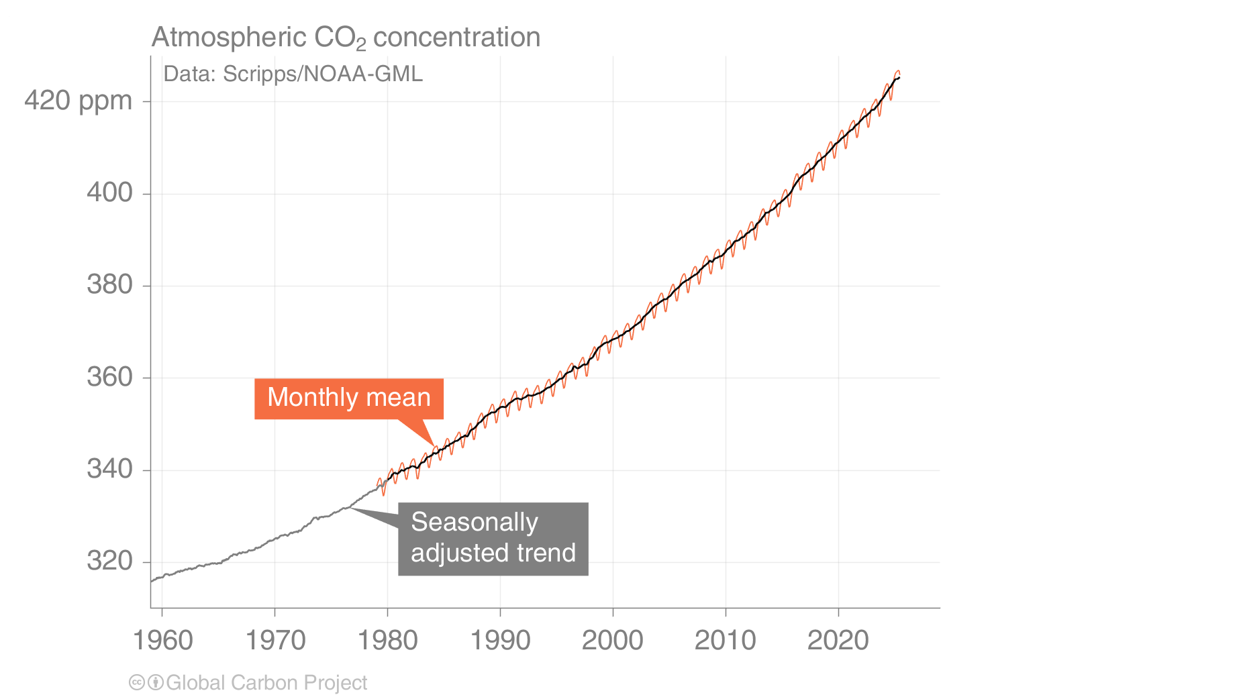
Atmospheric CO₂ concentration
The global CO₂ concentration increased from ~277 ppm in 1750 to 422.8 ppm in 2024 (up 53%)
Globally averaged surface atmospheric CO₂ concentration. Data from: NOAA-GML after 1980;
the Scripps Institution of Oceanography before 1980
Source: NOAA-GML; Scripps Institution of Oceanography; Friedlingstein et al 2025; Global Carbon Project 2025

Slide 20
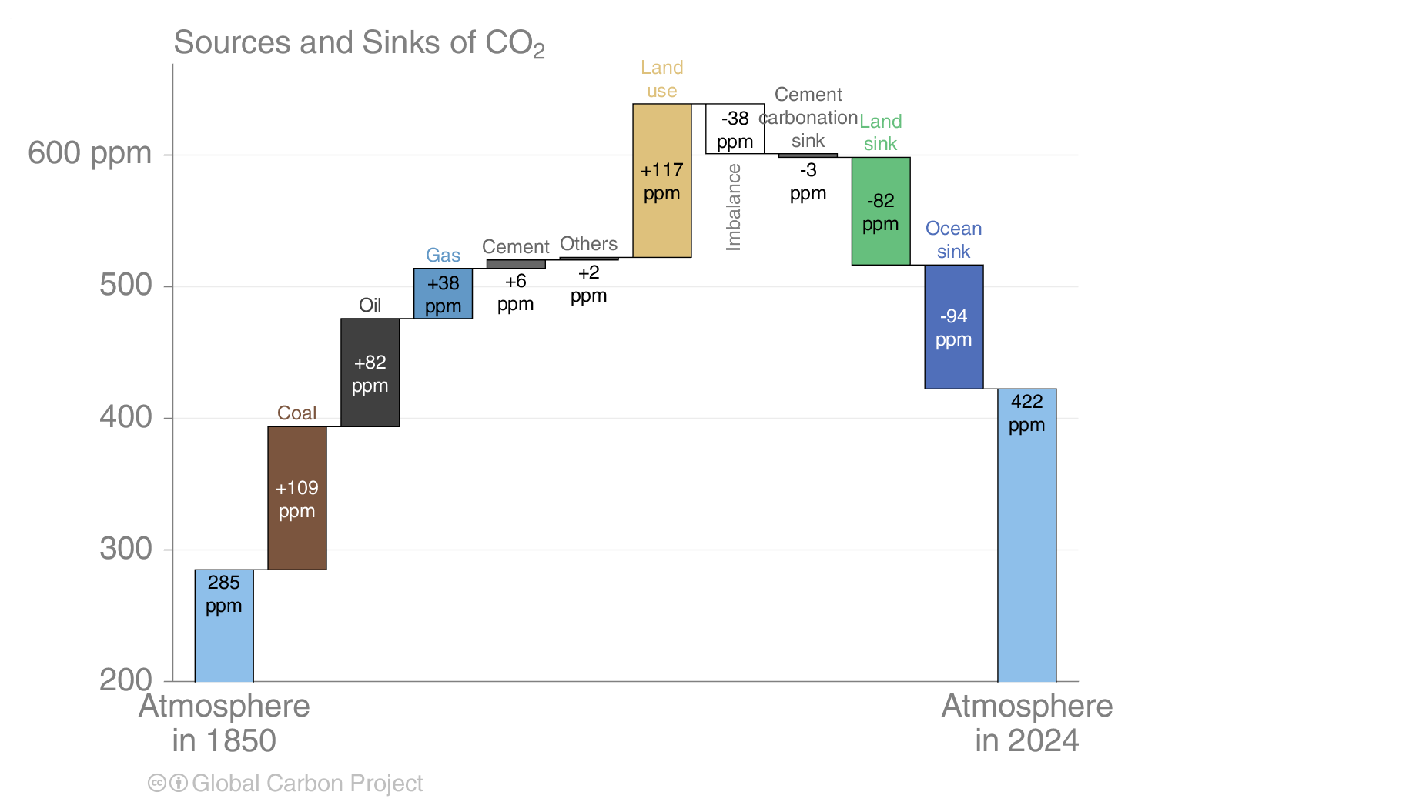
Global carbon budget
The cumulative contributions to the global carbon budget from 1850
The carbon imbalance represents the gap in our current understanding of sources & sinks
Source: Friedlingstein et al 2025; Global Carbon Project 2025

Slide 21
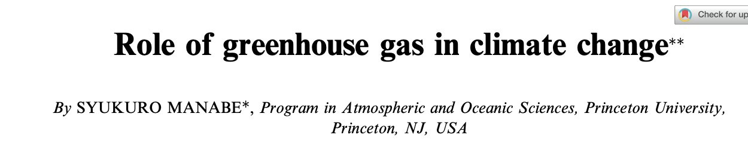
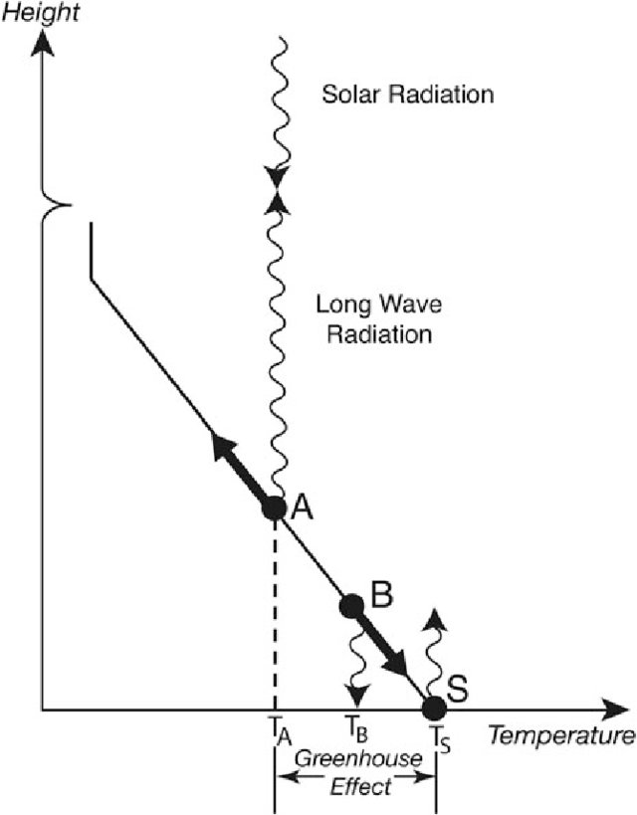
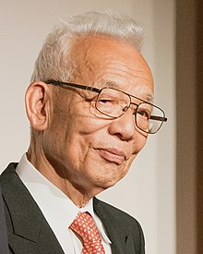
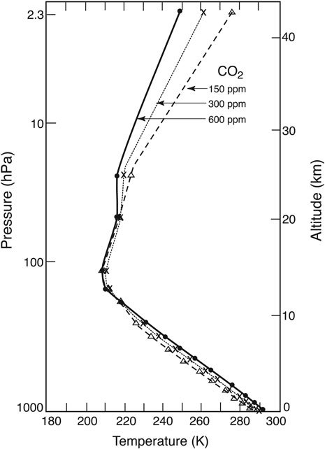
Nobel Prize for Physics 2021

Slide 22
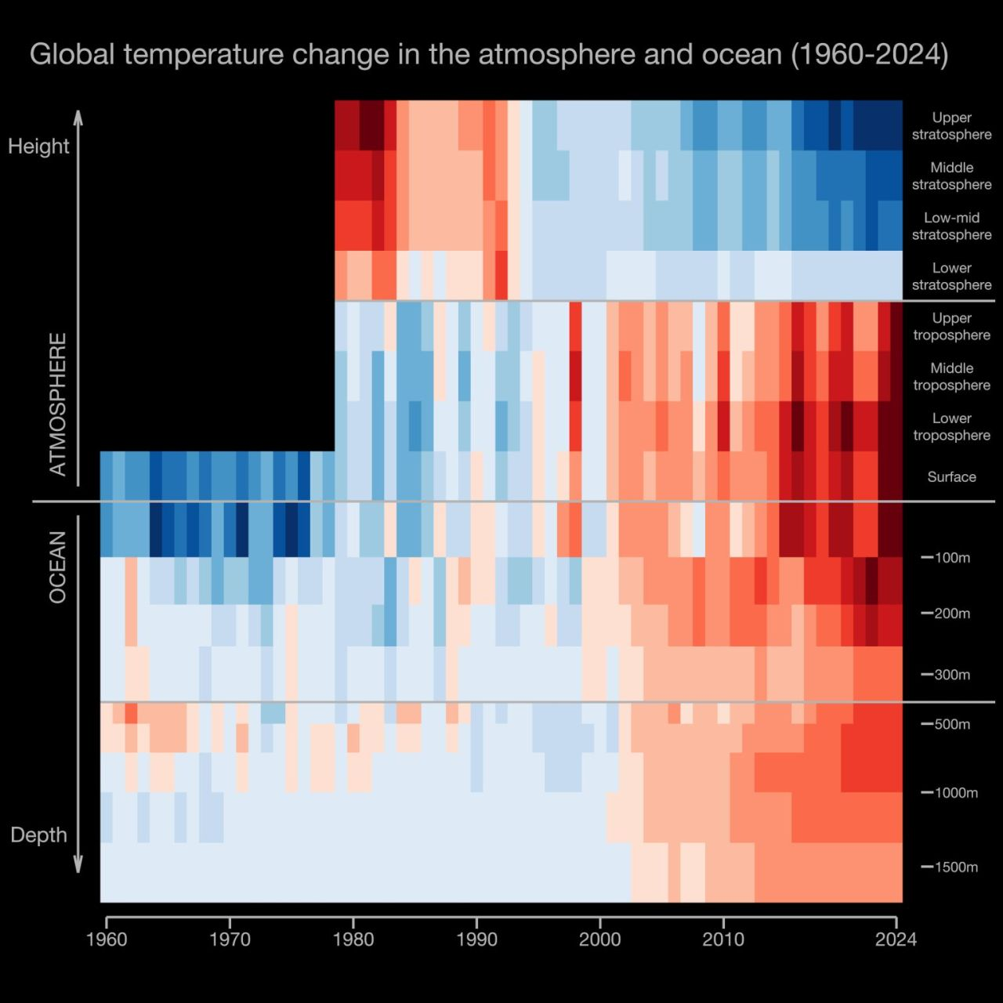
Air
Ocean
Hawkins et al., 2025, BAMS

Slide 23
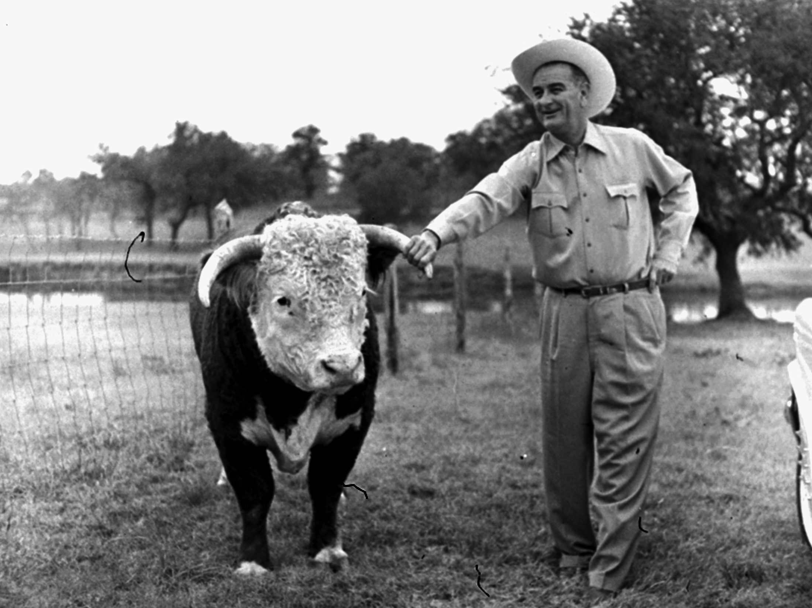
The continued release of CO₂ to the atmosphere from burning fossil fuels would “almost certainly cause significant changes” and “could be deleterious from the point of view of human beings […] and marked changes in climate, not controllable through local or even national efforts.
U.S. President's Science Advisory to President Lyndon B. Johnson 1966

Slide 24
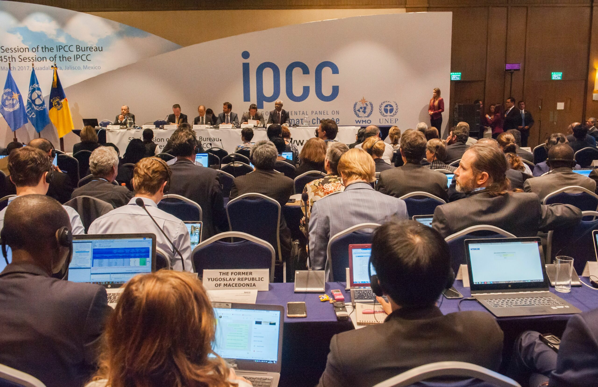
Insideclimatenews.org

Slide 25
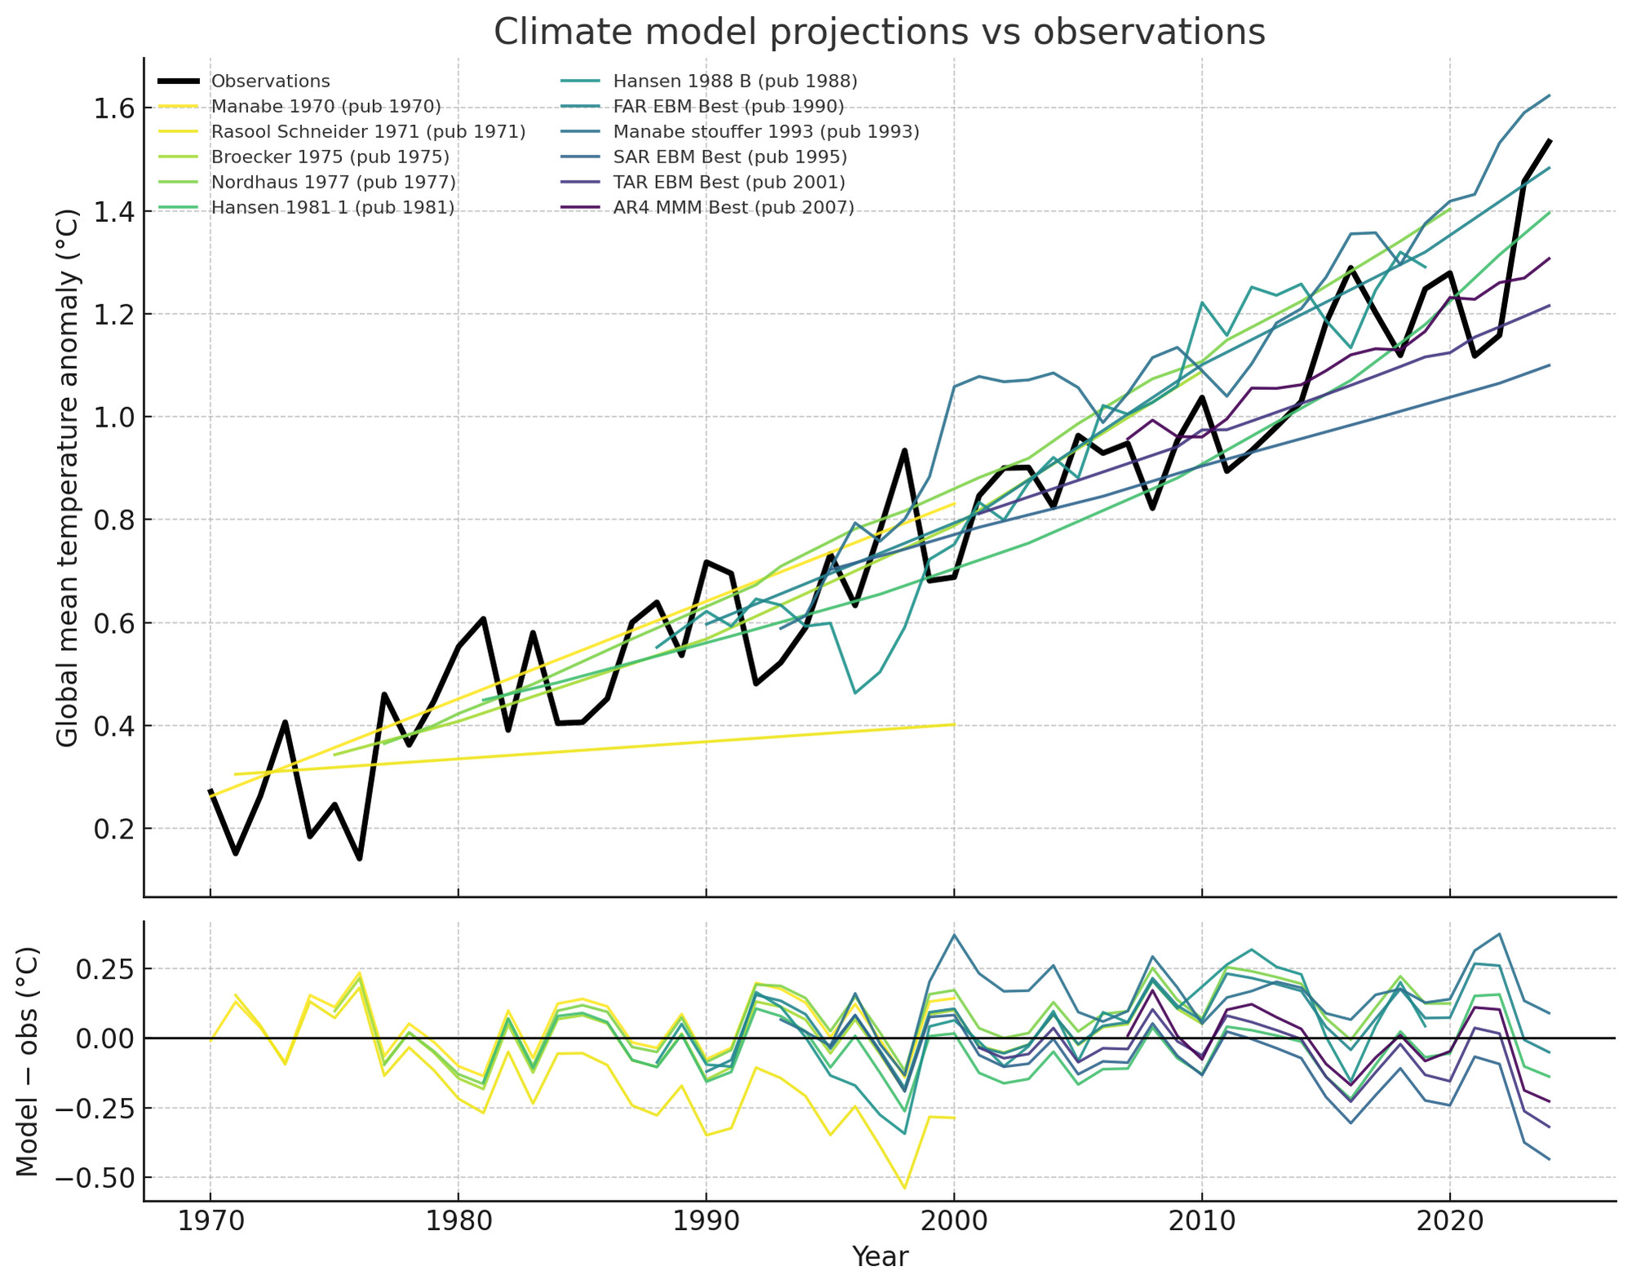
Hausfather et al., 2020

Slide 26
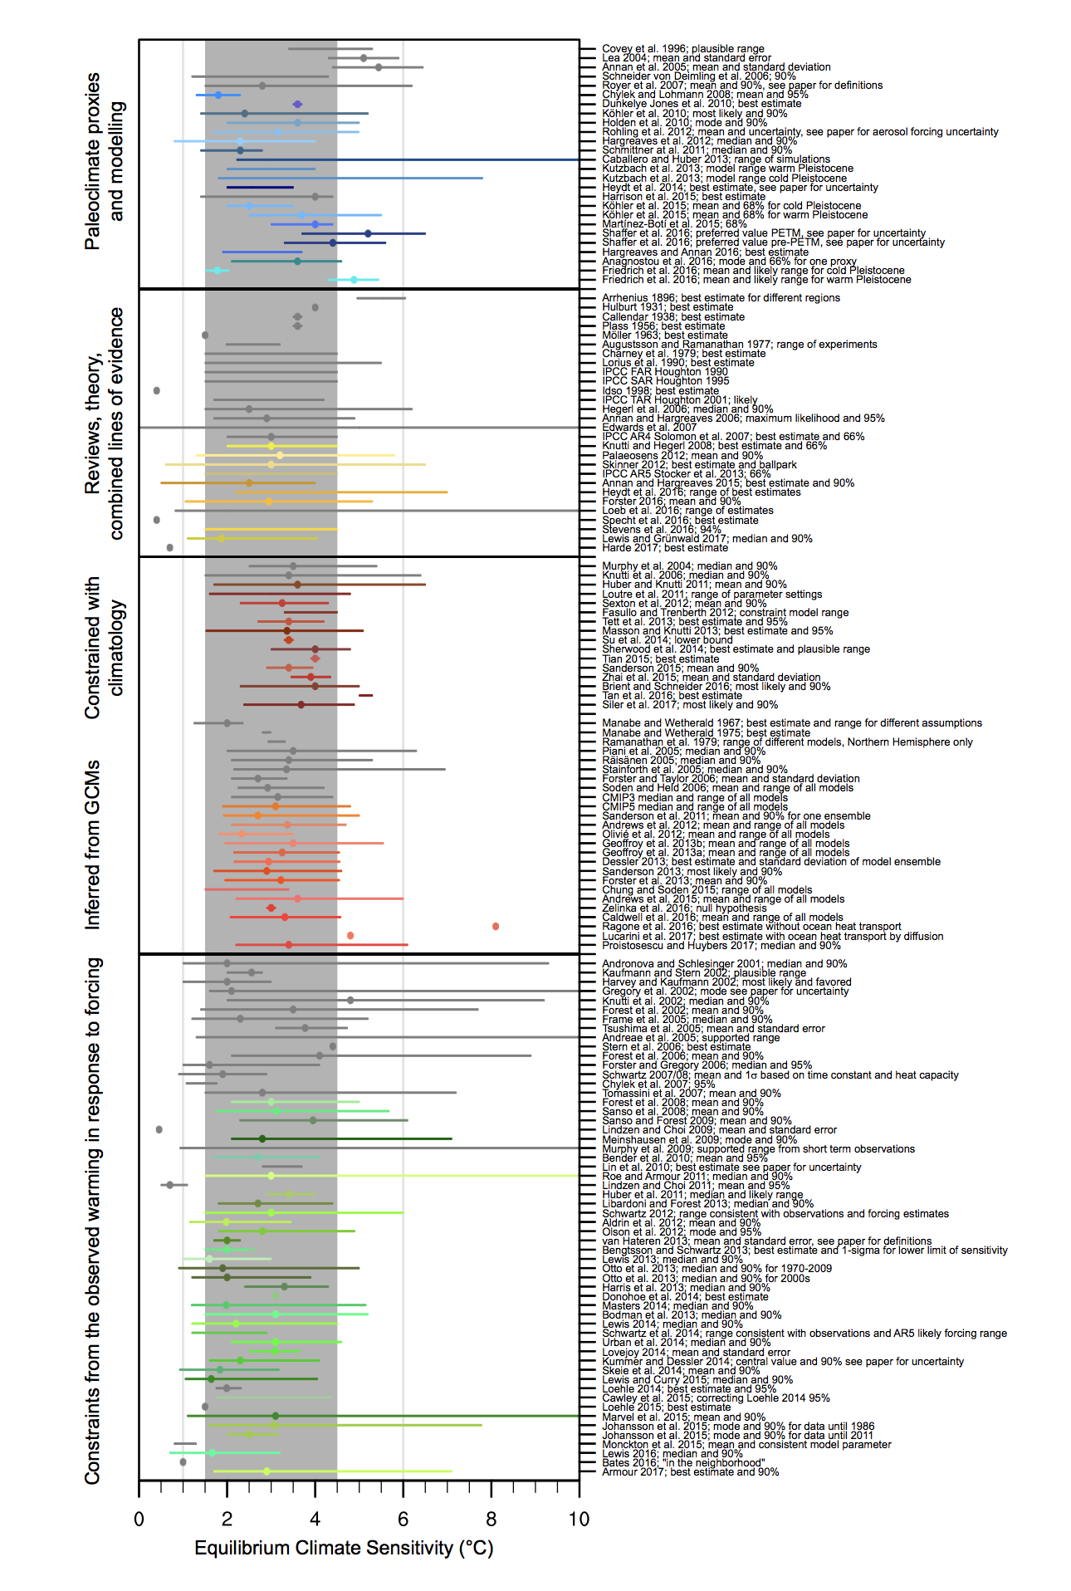
Ancient
Climate proxies
Physics
Theory
Climatology
Models
Modern
observations
Knutti et al, 2017

Slide 27
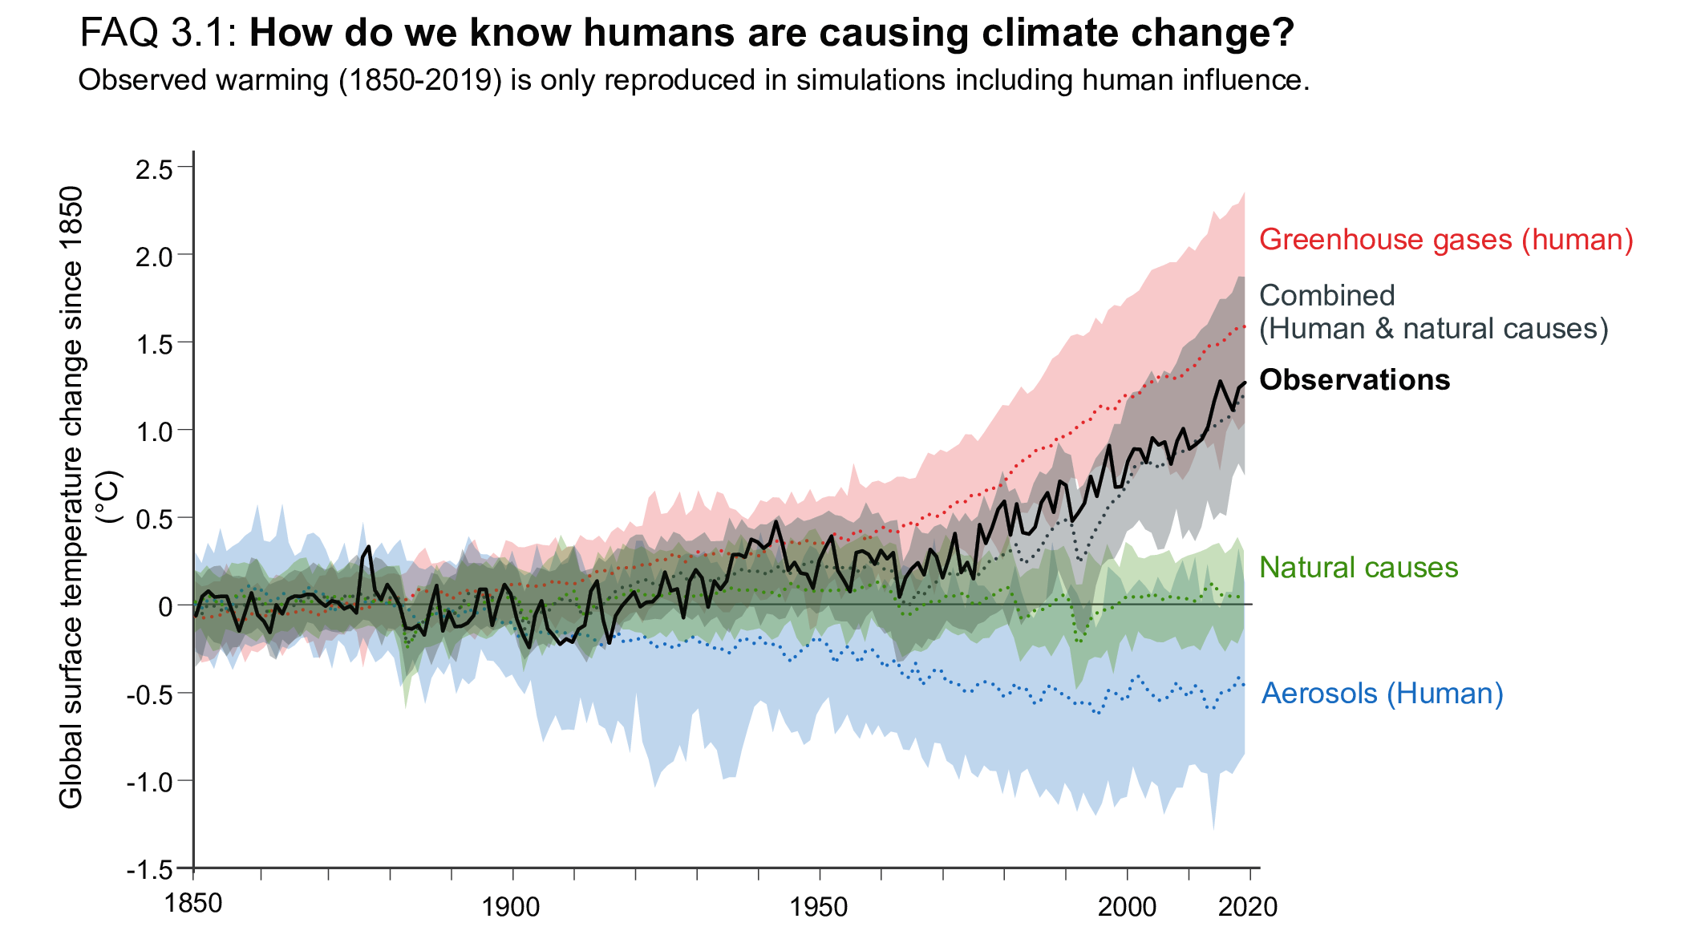
Fossil fuel emissions drive this and future impacts are large
IPCC AR6 WG1

Slide 28
What does it mean for us?
Increases in extreme weather events, heatwaves, floods, droughts are already impacting in many parts of the world
Sea-level rise, permafrost melt, glacial retreat harms infrastructure, water/power supply, coastal and small island flooding
Ecosystem function changes leading to spread of invasive species, vector-borne disease, algal blooms, and crop failures

Slide 29
A consequential decade
Ed Hawkins

Slide 30
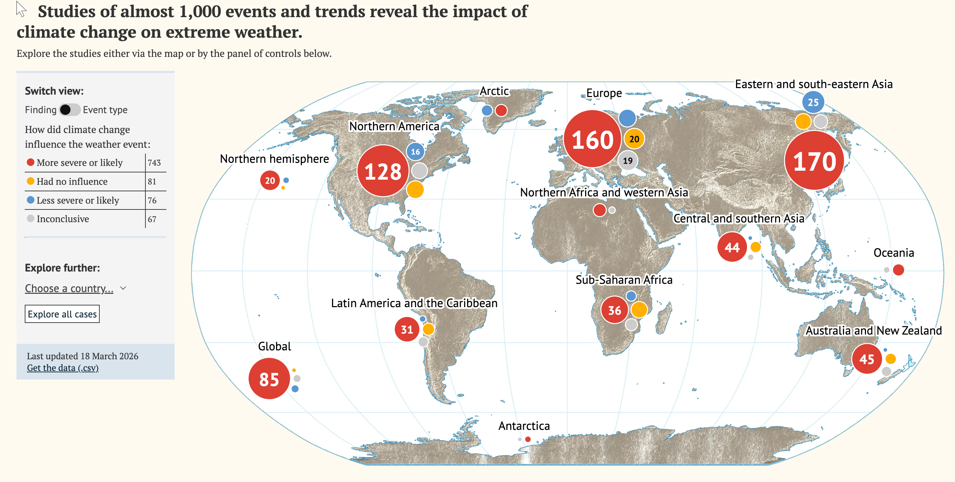
Climate Action Tracker

Slide 31
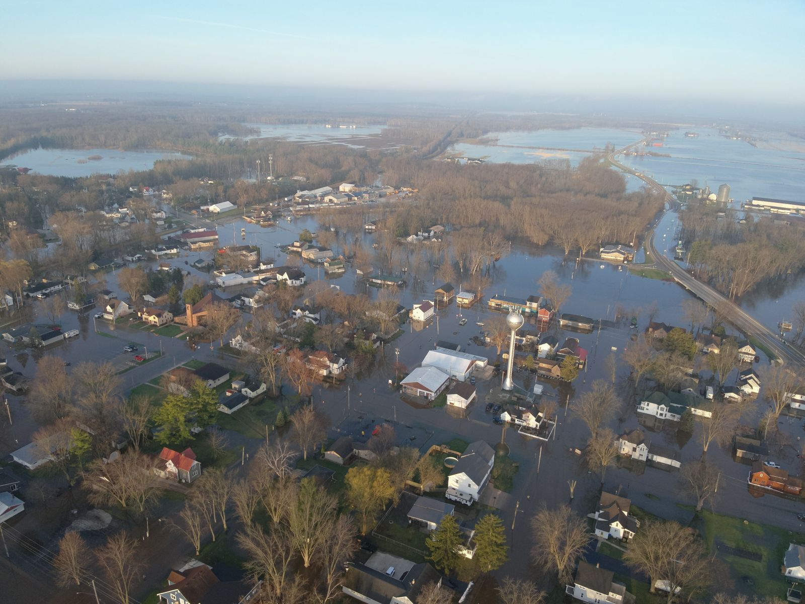
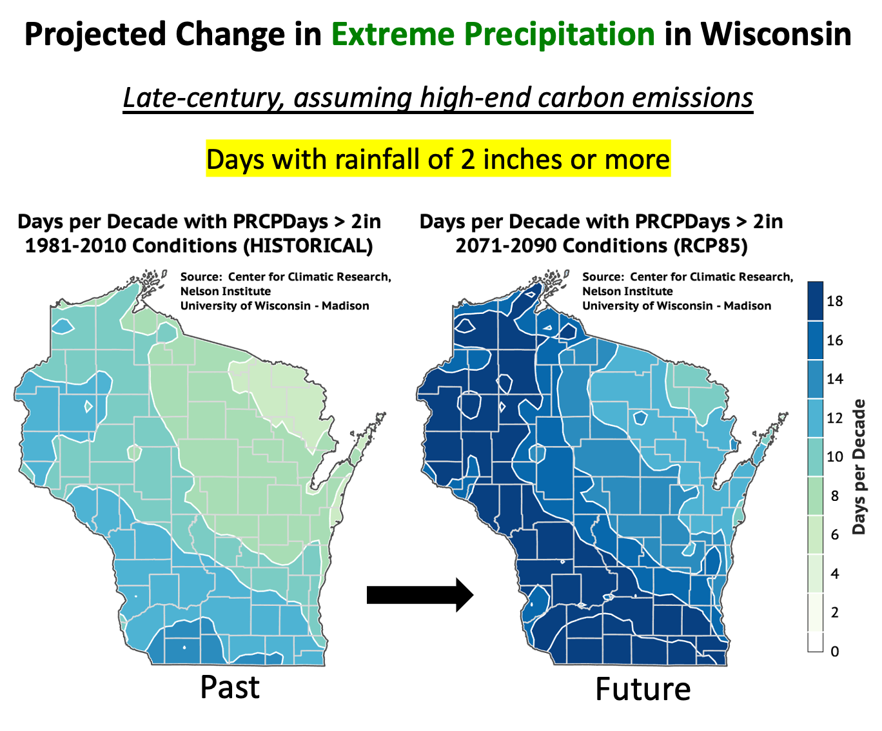
Shiocton, Outagamie County, April 17, 2026
WICCI, National Weather Service

Slide 32
What are we going to do about it?
Get educated
Get engaged
Get empowered

Slide 33
What Are The Options?
Adaptation
  Economic/political (relocation, tech transfer, payments for damages, reduce poverty, educate)
  Technological (resilient tech, seawalls, genetic hybrids, cure malaria, colonize new planet)
Mitigation

Slide 34
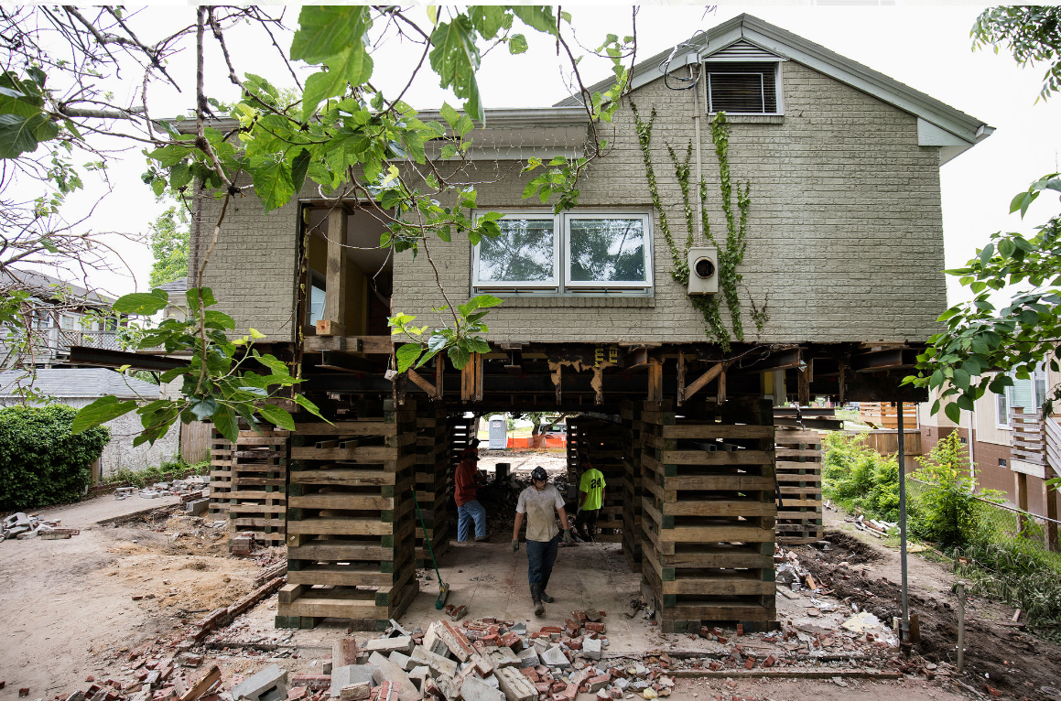
Wash Post

Slide 35
What Are The Options?
Adaptation
  Economic/political (relocation, tech transfer, payments for damages, reduce poverty, educate)
  Technological (resilient tech, seawalls, genetic hybrids, cure malaria, colonize new planet)
Mitigation
  Economic (taxes, cap and trade, R&D)
  Regulatory (treaties, bans, compacts, fuel/energy standards, public transit, voluntary agreements)
  Societal (sustainable development, education)
  Technological (CO₂ capture, geoengineering, green tech, alternative energy, energy efficiency)

Slide 36
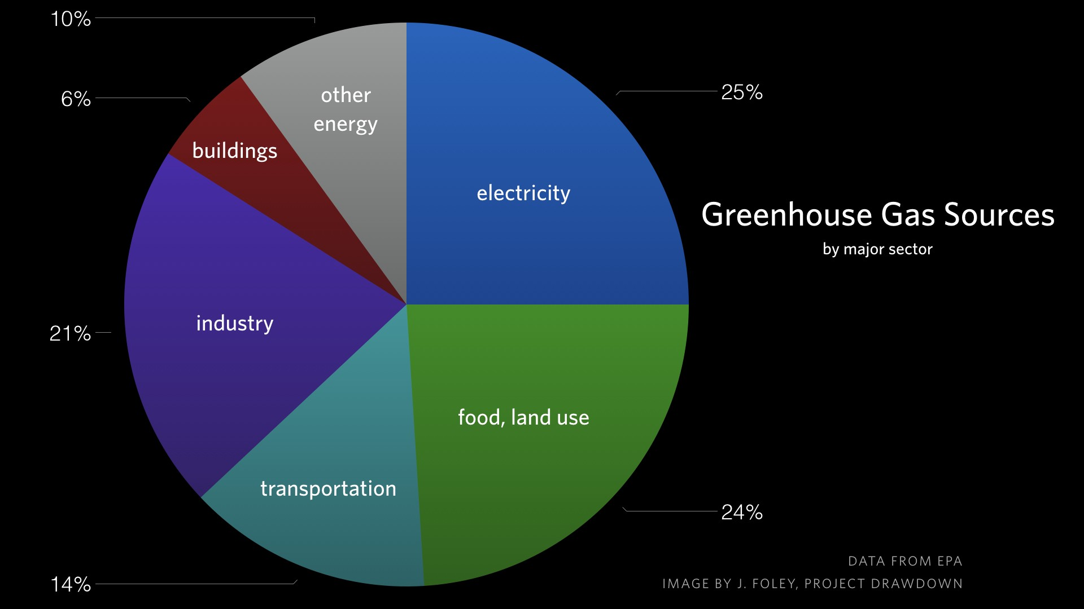
Fundamentally, to mitigate, society has to reduce greenhouse gas concentration of the atmosphere

Slide 37
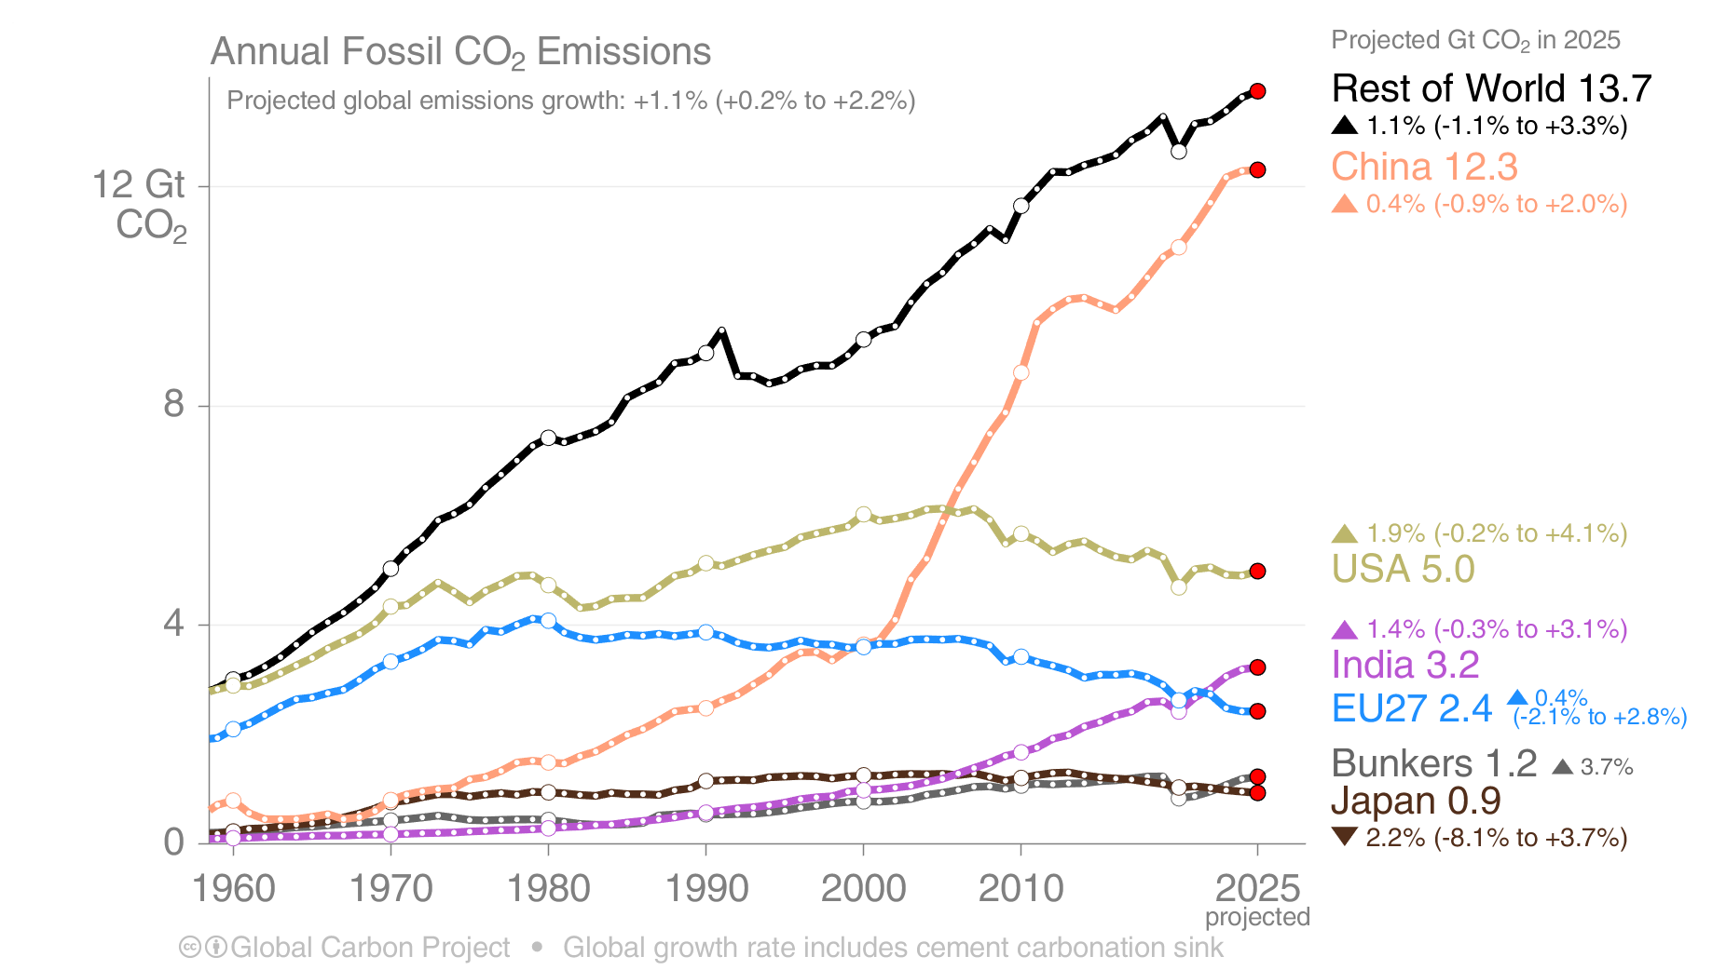
Emissions Projections for 2025
Fossil CO₂ emissions growth is from different regions in 2025 compared to 2024:
The USA rising, and EU27 flat, reversing recent declines. China flat, India low growth, contrasting recent strong growth.
The 2025 projections are based on preliminary data and modelling.
‘Bunkers’ are fossil fuels used for international shipping and aviation
Source: Friedlingstein et al 2025; Global Carbon Project 2025

Slide 38
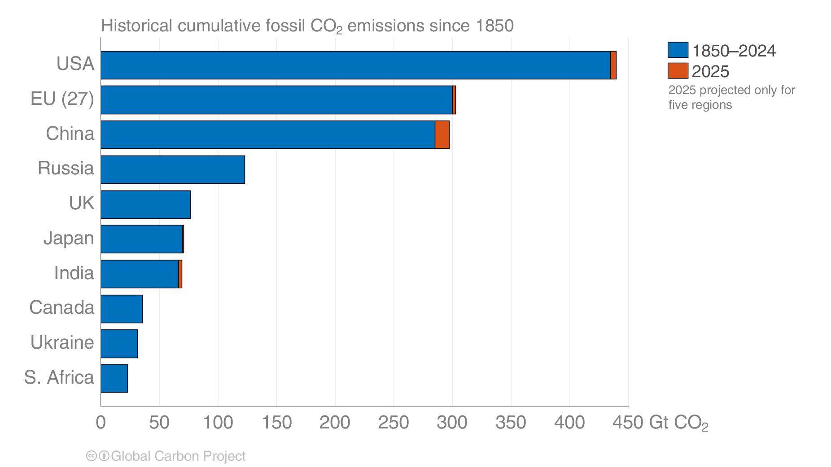
Historical cumulative fossil CO₂ emissions
The USA and EU have the highest accumulated fossil CO₂ emissions since 1850, but China is a close third.
Calculated using territorial emissions.
Source: Friedlingstein et al 2025; Global Carbon Project 2025

Slide 39
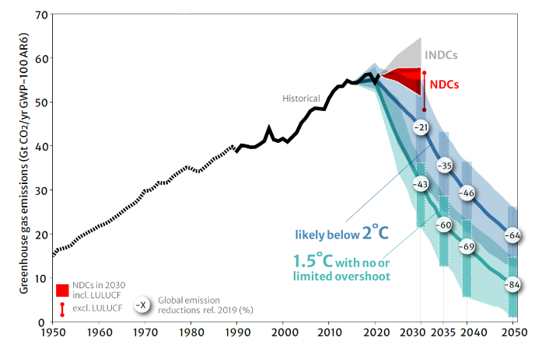

Slide 40
We are not all doomed if we:
We talk about it
We consider actions that make an impact
We hold elected leaders accountable

Slide 41


Slide 42

Solar is the fastest growing + cheapest source of electricity globally
Wikimedia

Slide 43



Can we grow food and generate renewable electricity at the same time? If so, what are the ecosystem impacts?
Landuse conversion
Agrivolatics!

Slide 44



Slide 45



CO₂ uptake is strongest in partial shade

Slide 46


Slide 47



Credits:
Kim Novick (U Indiana)
Stefan Metzger (Battelle/NEON)
Susi Wiesner (USDA)

Slide 48


Slide 49

Carbon dioxide removal is a solution, but secondary

Slide 50
Solutions are broad in approach
https://www.drawdown.org/explorer

Slide 52

There is support!
https://climatecommunication.yale.edu/visualizations-data/ycom-us/

Slide 53

We have ample solutions to address climate change impacts
e.g.,
Economic/policy regulation, finance
Carbon capture and storage
Non or low greenhouse gas polluting fuels and energy
Sustainable, efficient design of homes, industry, transport, cities
Geoengineering / Solar radiation management
But how do we get them to scale?
And in a way that is fair to people, environment, society?

Slide 54

Thank you!
Ankur Desai
desai@aos.wisc.edu
https://flux.aos.wisc.edu
@profdesai (bsky)
Jeff Miller UW-Communications

Slide 55
Ask me about
Super El Niño
Renewable energy in Wisconsin
Data centers and AI
Electric vehicles
Capturing carbon in trees, soil, underground
Changing seasons
Extreme weather (hurricanes, tornadoes, floods)
Sea level rise and ocean acidification
Role of scientists in informing policy
Misinformation – who and why
World population
Impact of meat production on climate
Alarmism, denial, and doomerism
The Paris Agreement, carbon trading, cap and trade
Current status of federal science policy, funding, court cases

